Slide 1
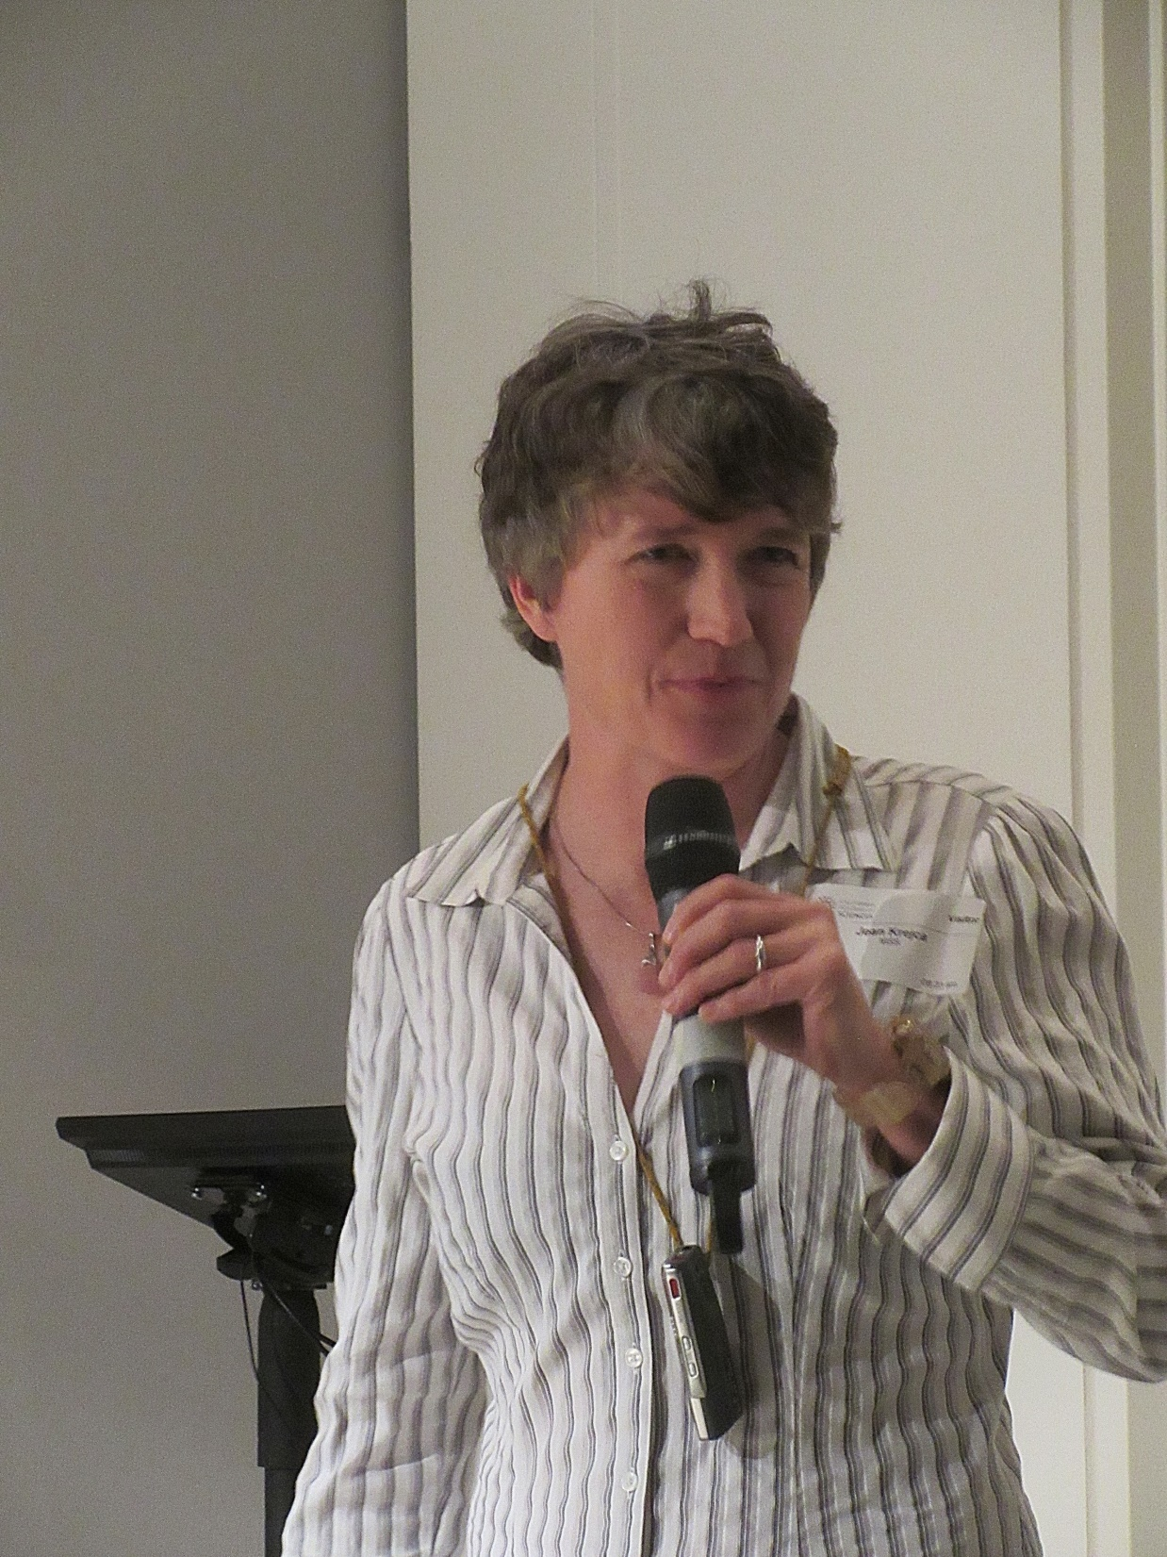
Dr. Jean Krejca

Slide 2
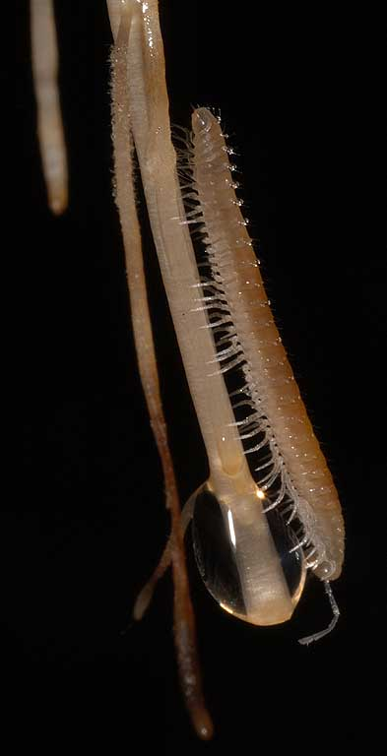
Cave Biology Studies
and photography
at National Parks (and Monuments)
Jean Krejca
Zara Environmental, LLC, Texas
&
Steve Taylor
Colorado College, Colorado
Plumatyla humerosa Loomis 1943
Notes:
Photographs and powerpoint slides are Copyright © 2005 by Steven J. Taylor and Jean K. Krejca
Permission for one time use only, and only with written permission from copyright holders.

Slide 3
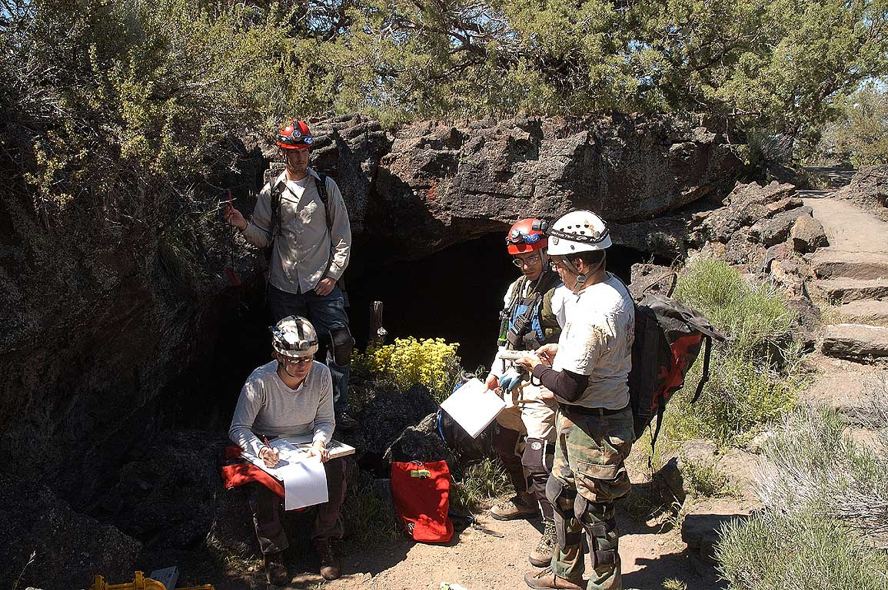
Outline of this talk:
Three national monument/park sites
What the caves are like
Maybe some interesting factoid to take home to the family
Valentine Cave,
Lava Beds
National Monument
Notes:
Photographs and powerpoint slides are Copyright © 2005 by Steven J. Taylor and Jean K. Krejca
Permission for one time use only, and only with written permission from copyright holders.

Slide 4
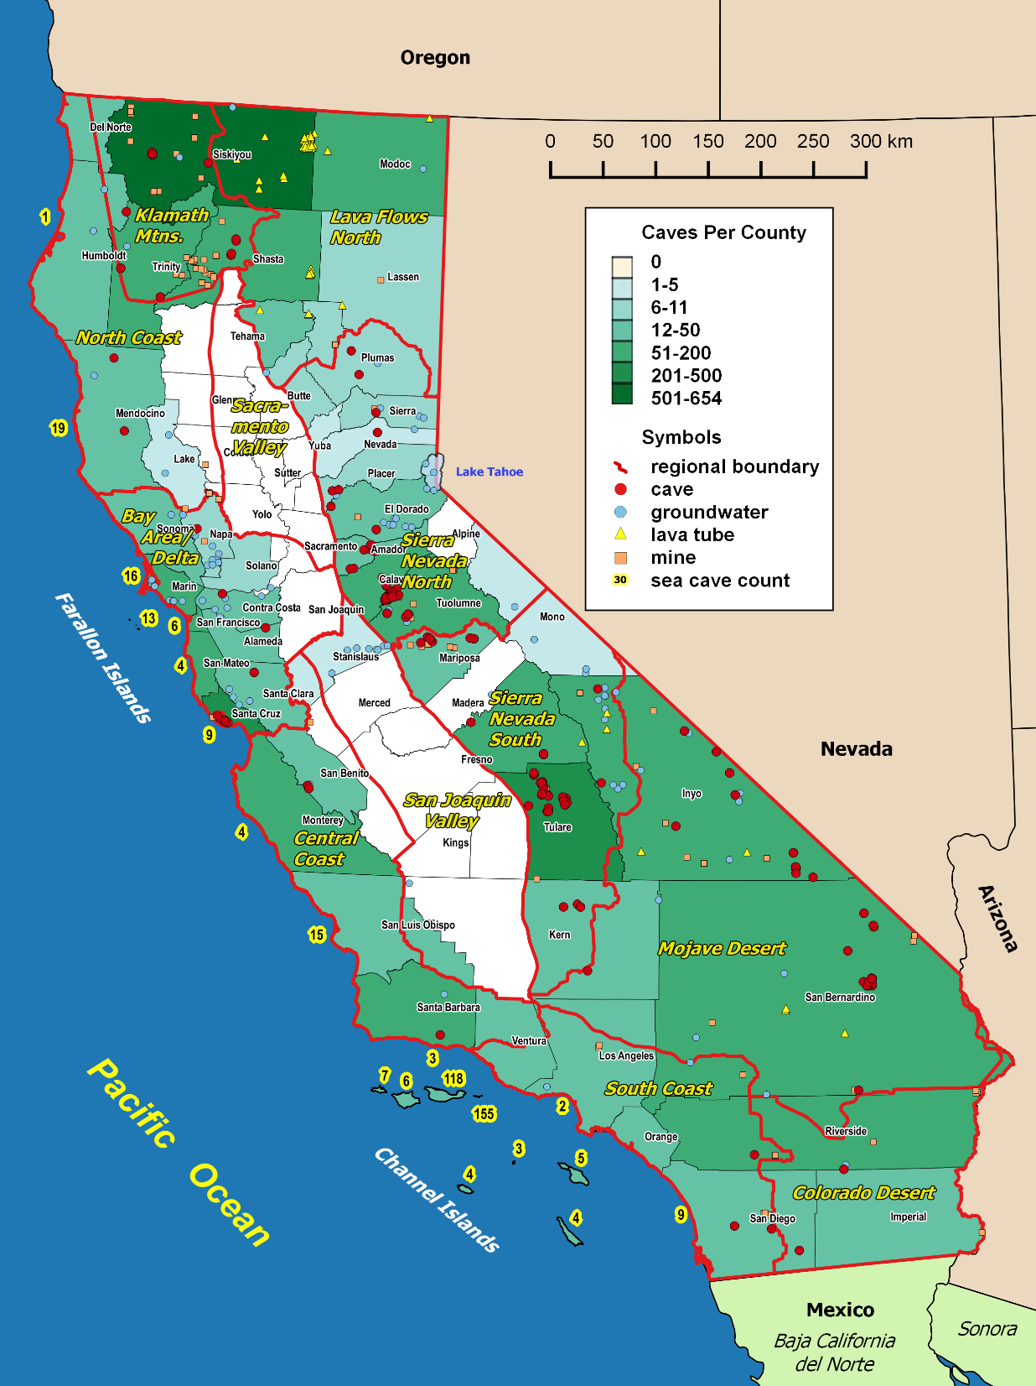
Lava Beds N. M.: three cheers to… Dave Larson
Yosemite Nat. Park: three cheers to… Greg Stock
Sequoia and Kings Canyon Nat. Parks: three cheers to… Joel Despain, Danny Boiano, Shane Fryer and Annie Esperanza
Notes:
Photographs and powerpoint slides are Copyright © 2005 by Steven J. Taylor and Jean K. Krejca
Permission for one time use only, and only with written permission from copyright holders.

Slide 5
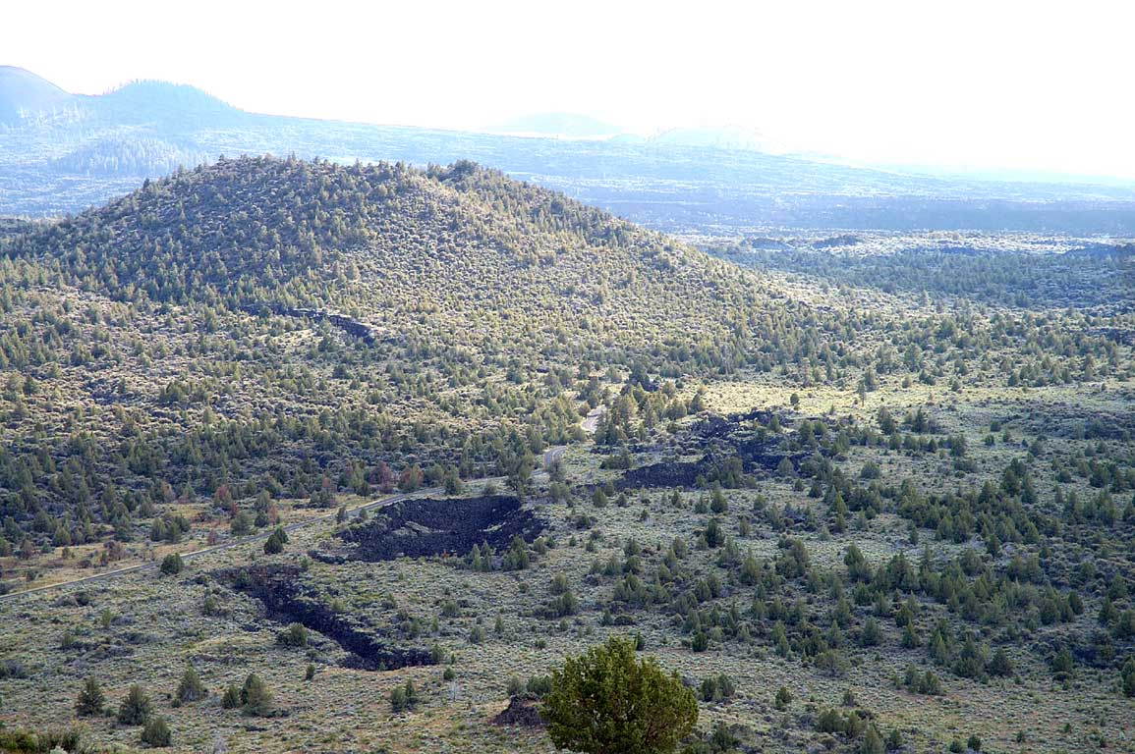
Lava Beds
National Monument
Notes:
Photographs and powerpoint slides are Copyright © 2005 by Steven J. Taylor and Jean K. Krejca
Permission for one time use only, and only with written permission from copyright holders.

Slide 6
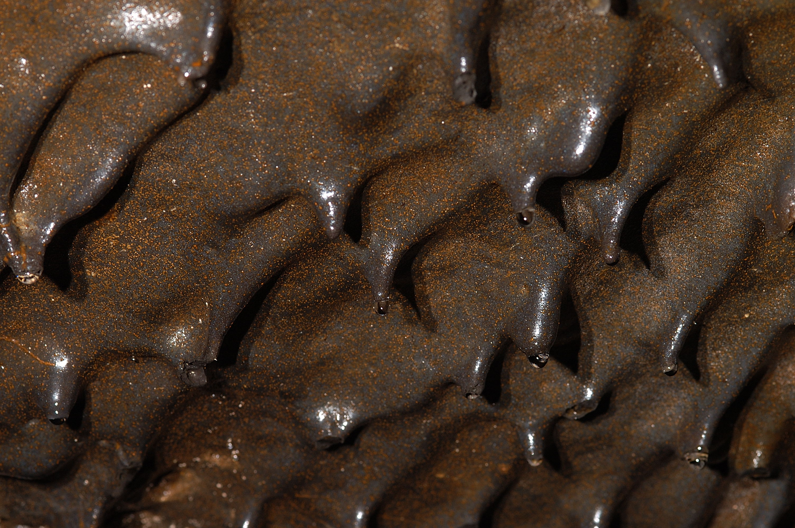
Caves formed in LAVA

Slide 7
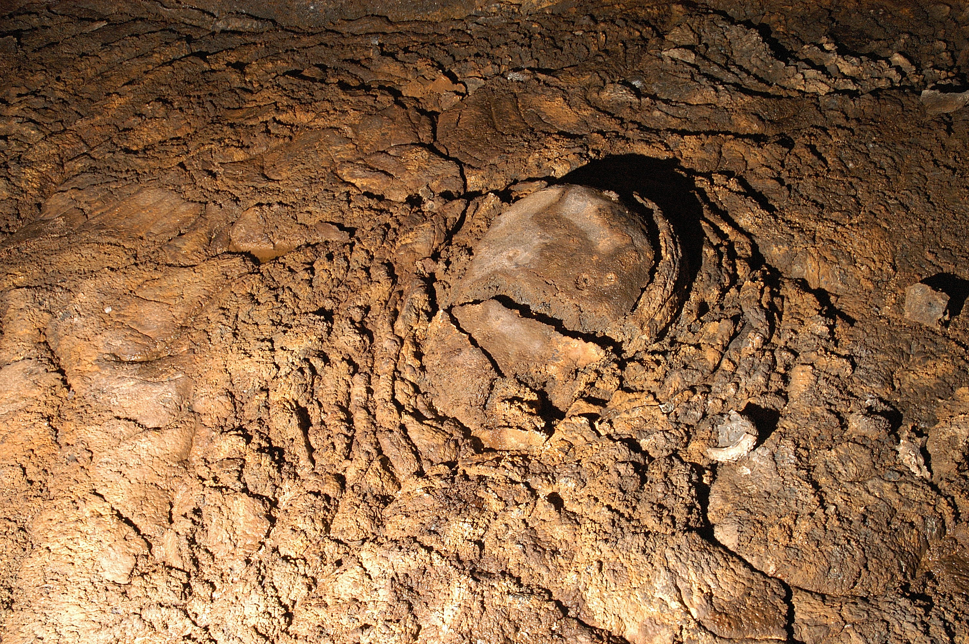

Slide 8
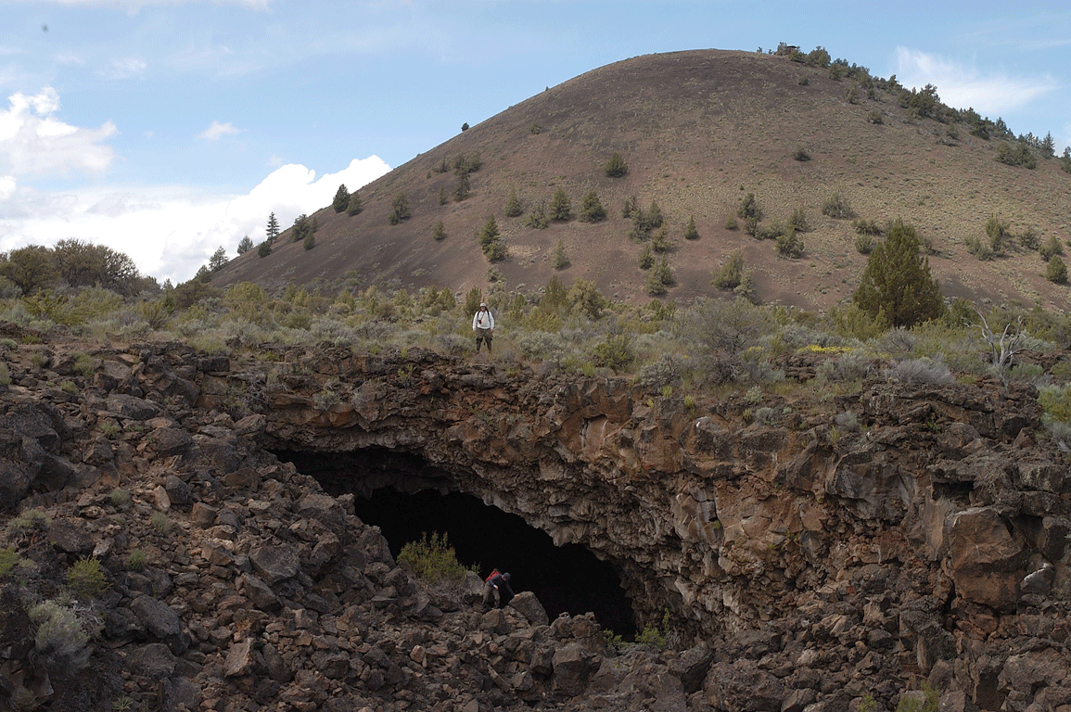

Slide 9
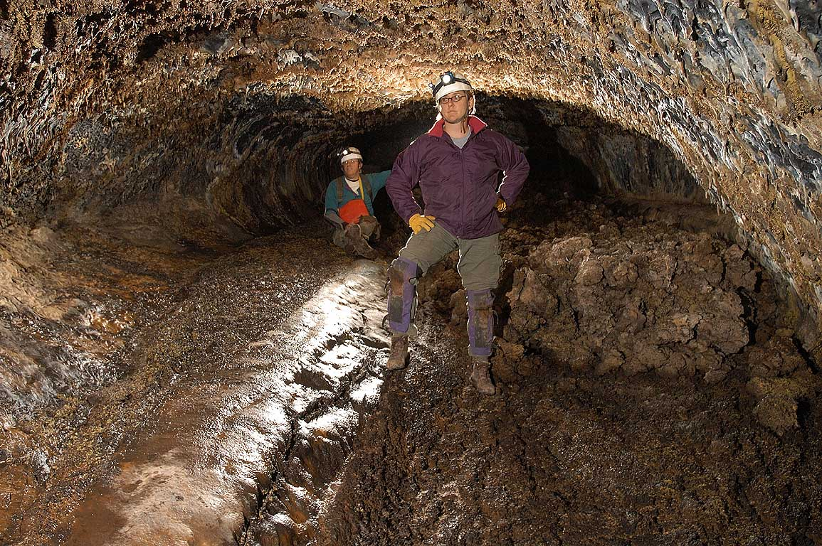
Photo by Jean Krejca
Coral Reef Cave,
Lava Beds National Monument
Notes:
Photographs and powerpoint slides are Copyright © 2005 by Steven J. Taylor and Jean K. Krejca
Permission for one time use only, and only with written permission from copyright holders.

Slide 10
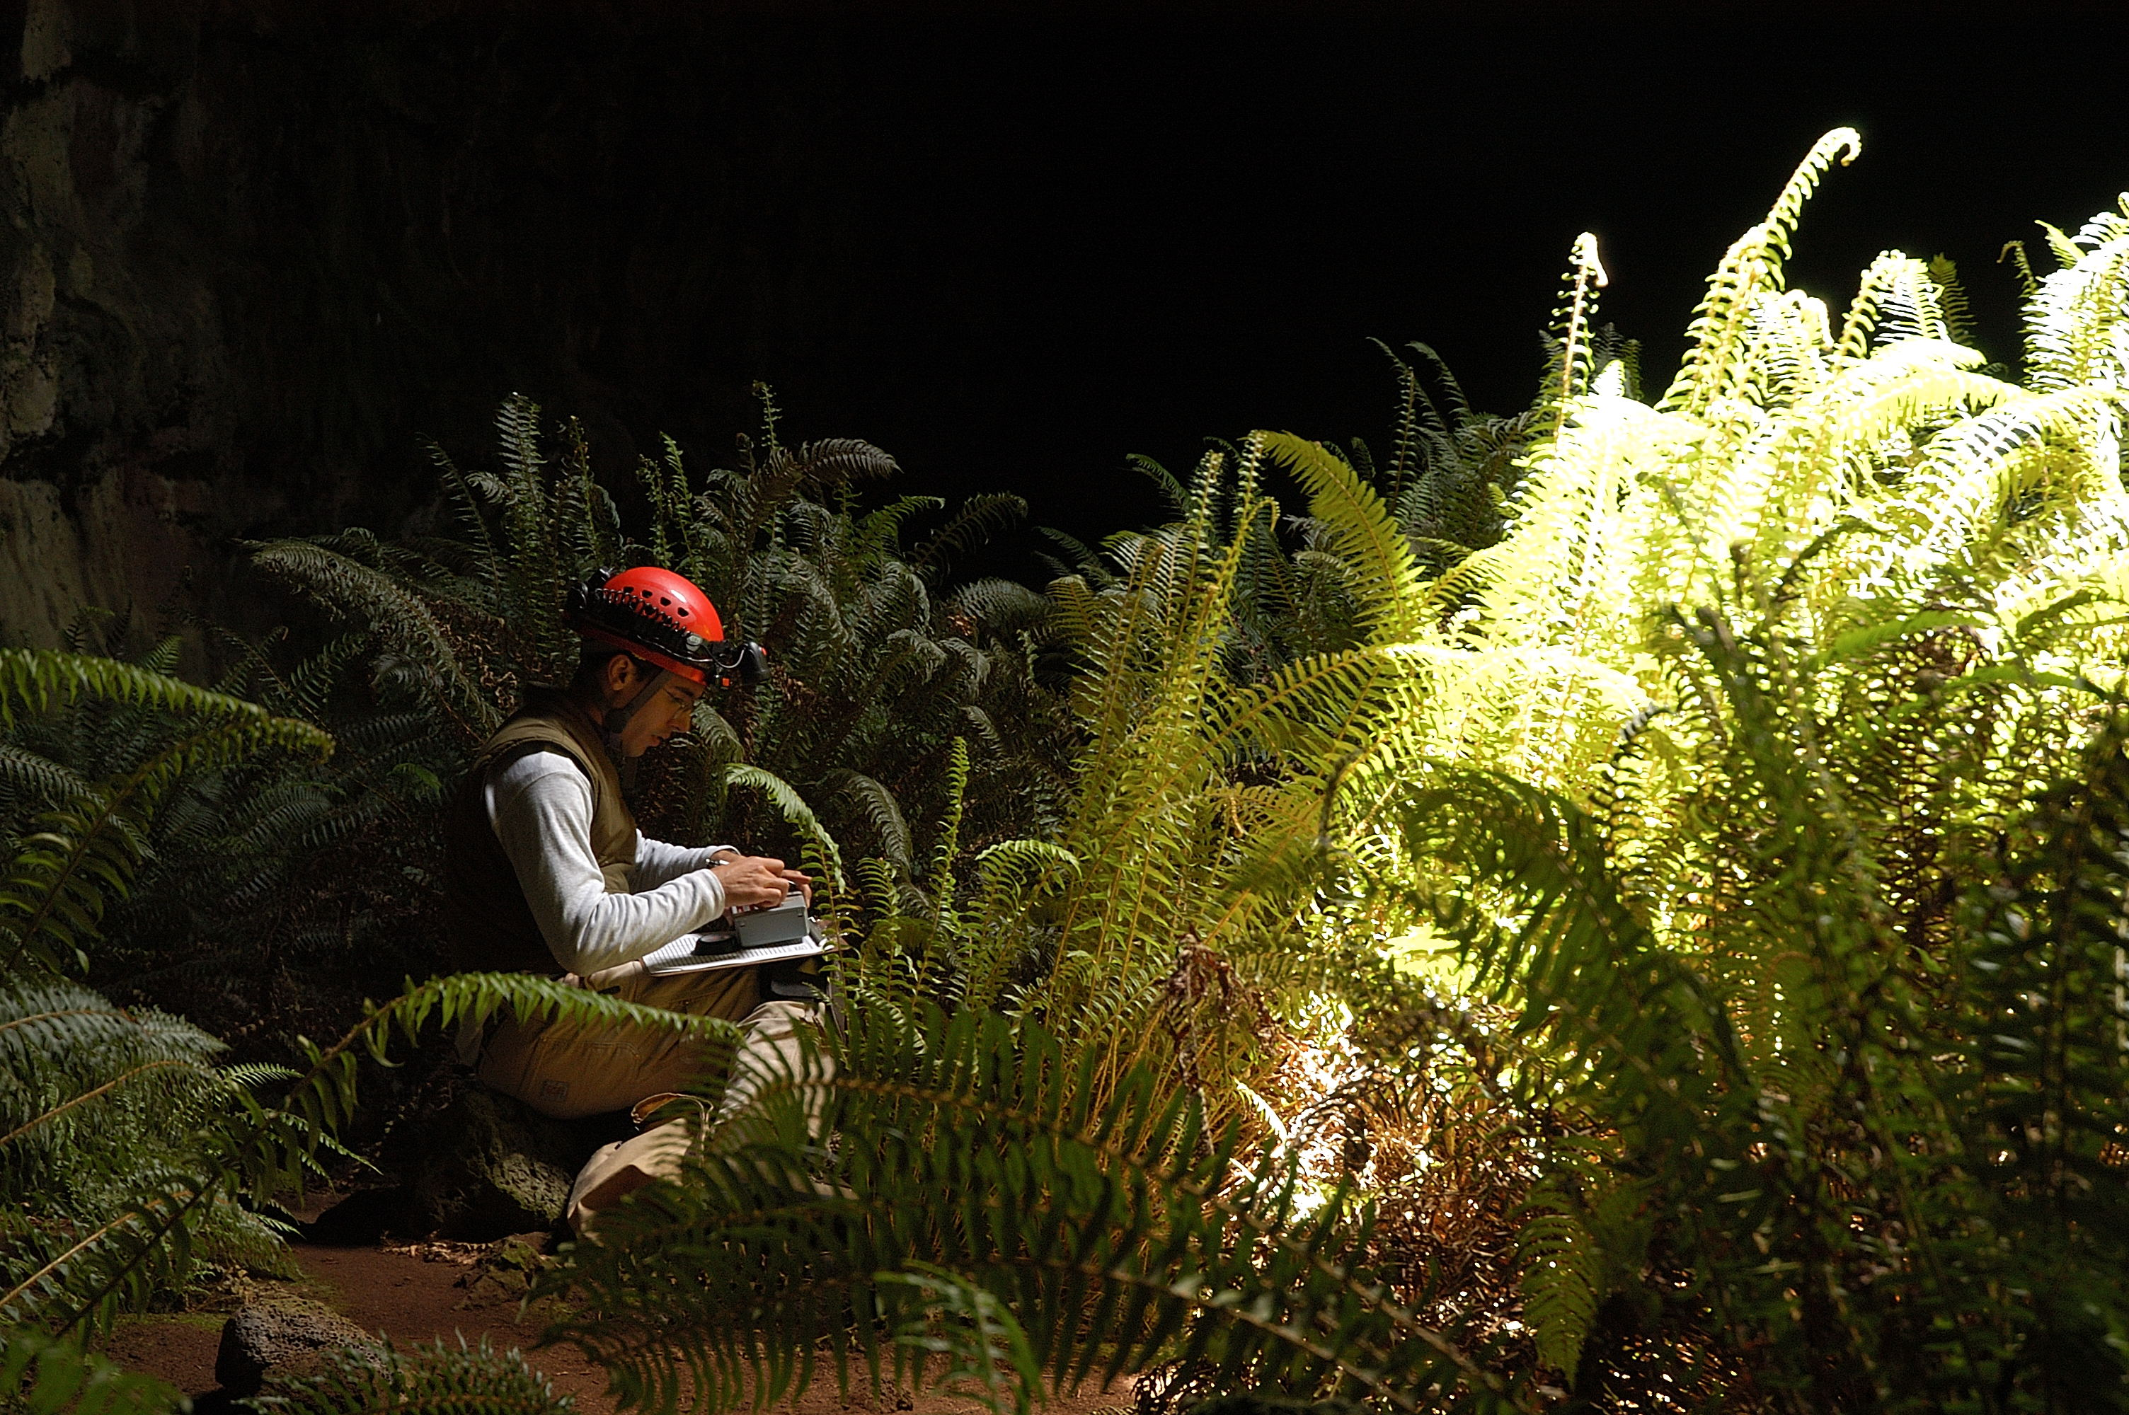

Slide 11
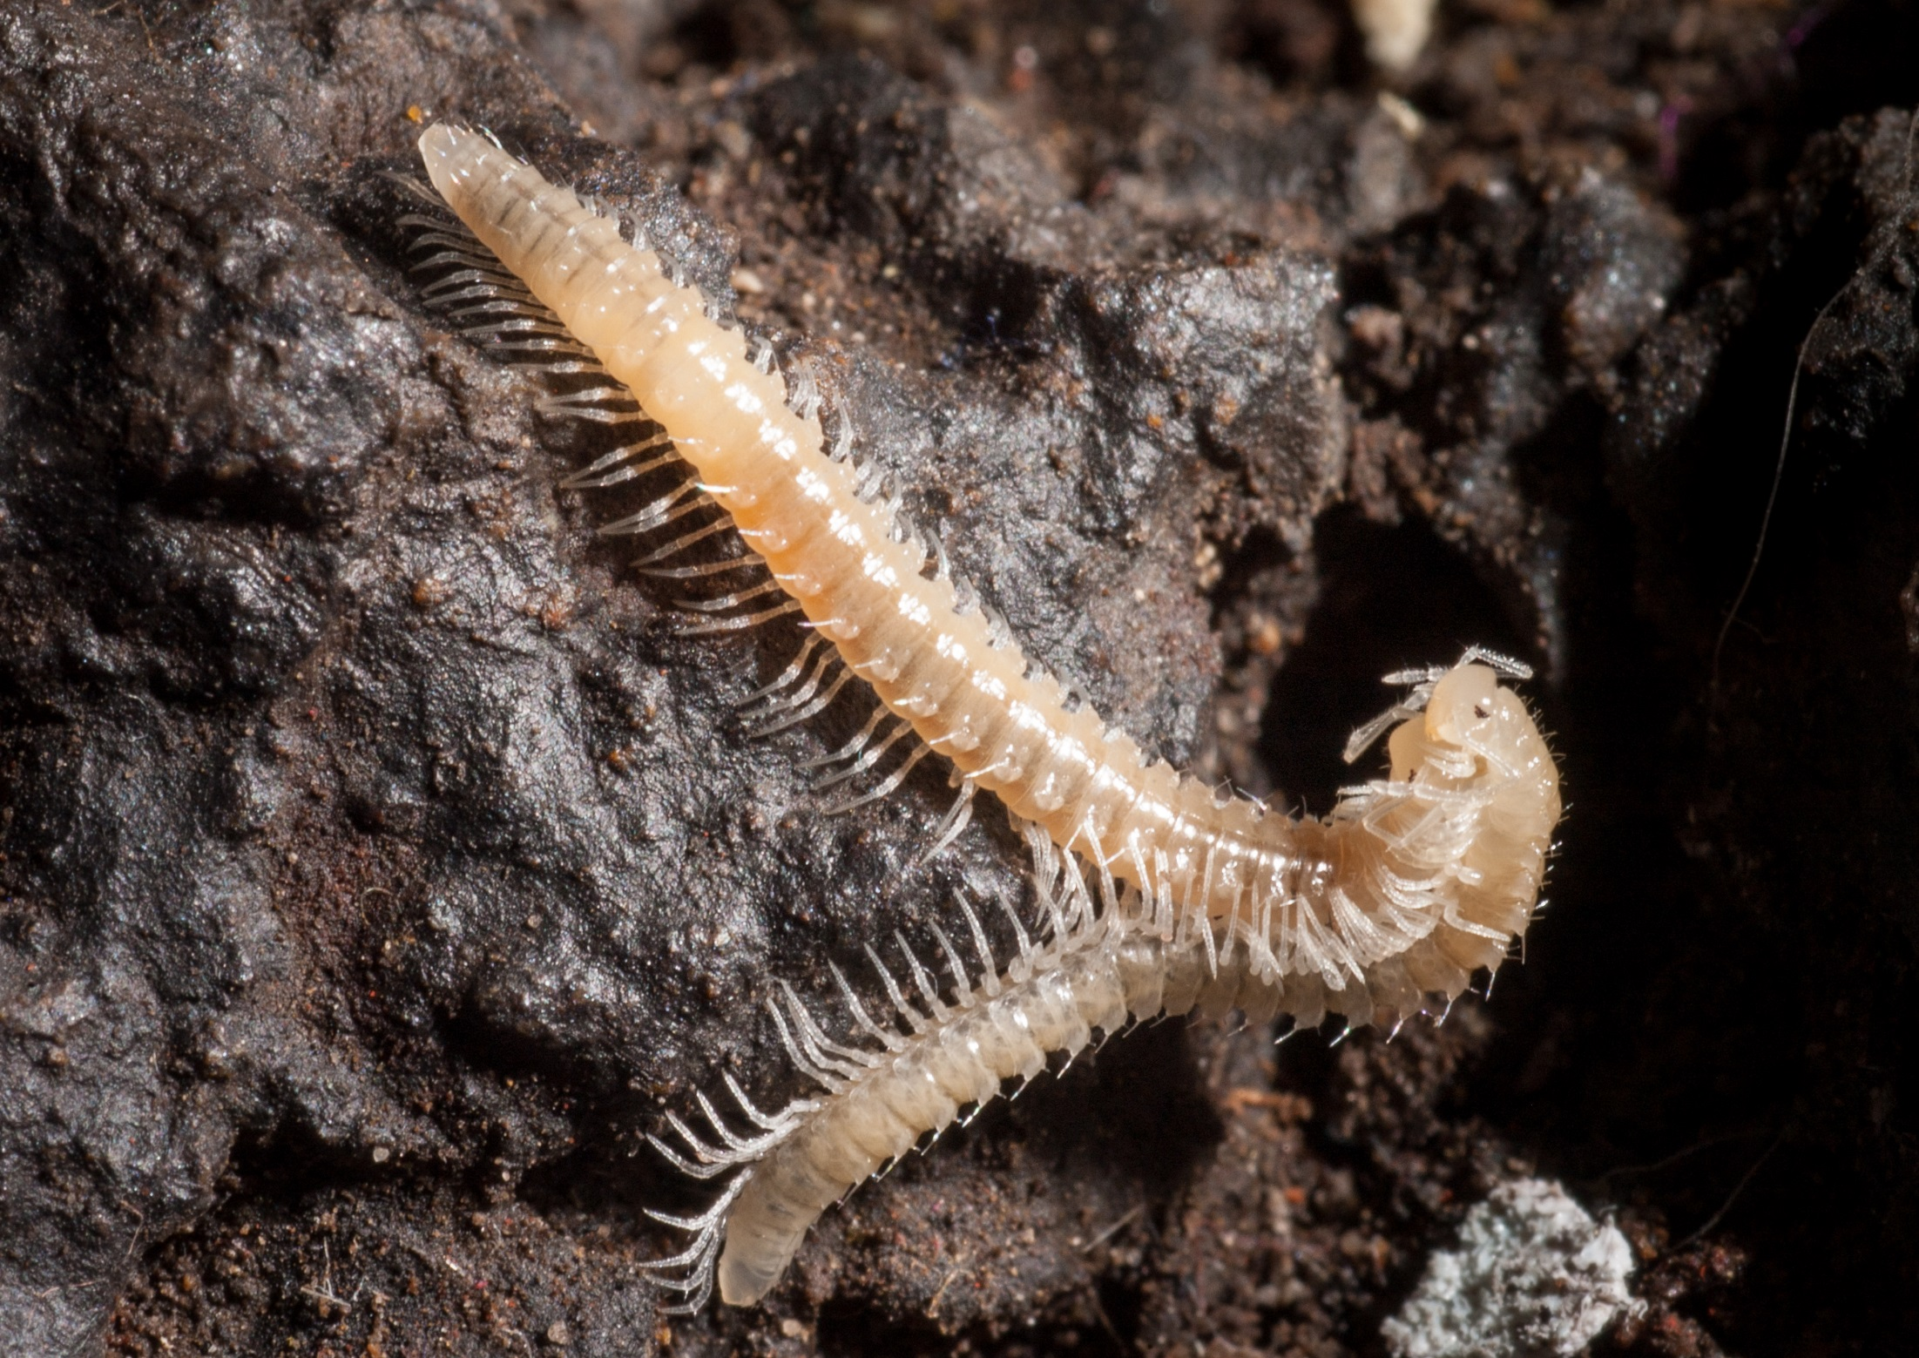

Slide 12
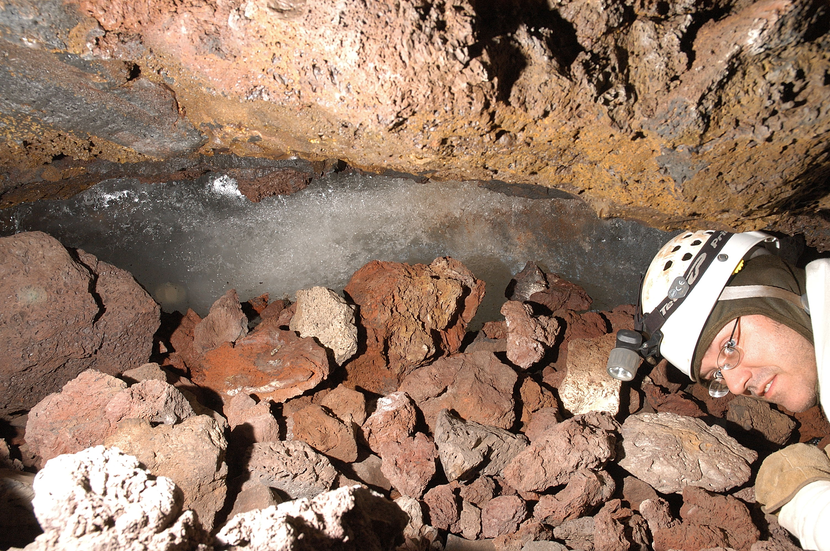
ICE

Slide 13
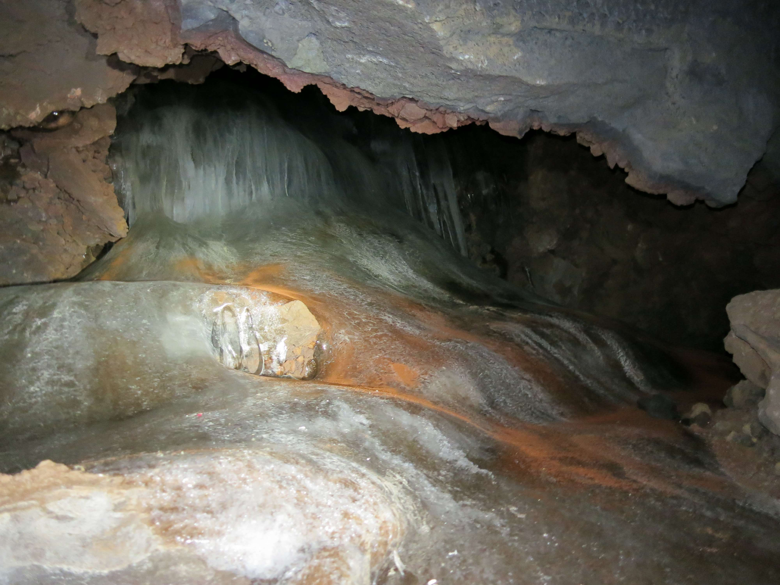

Slide 14
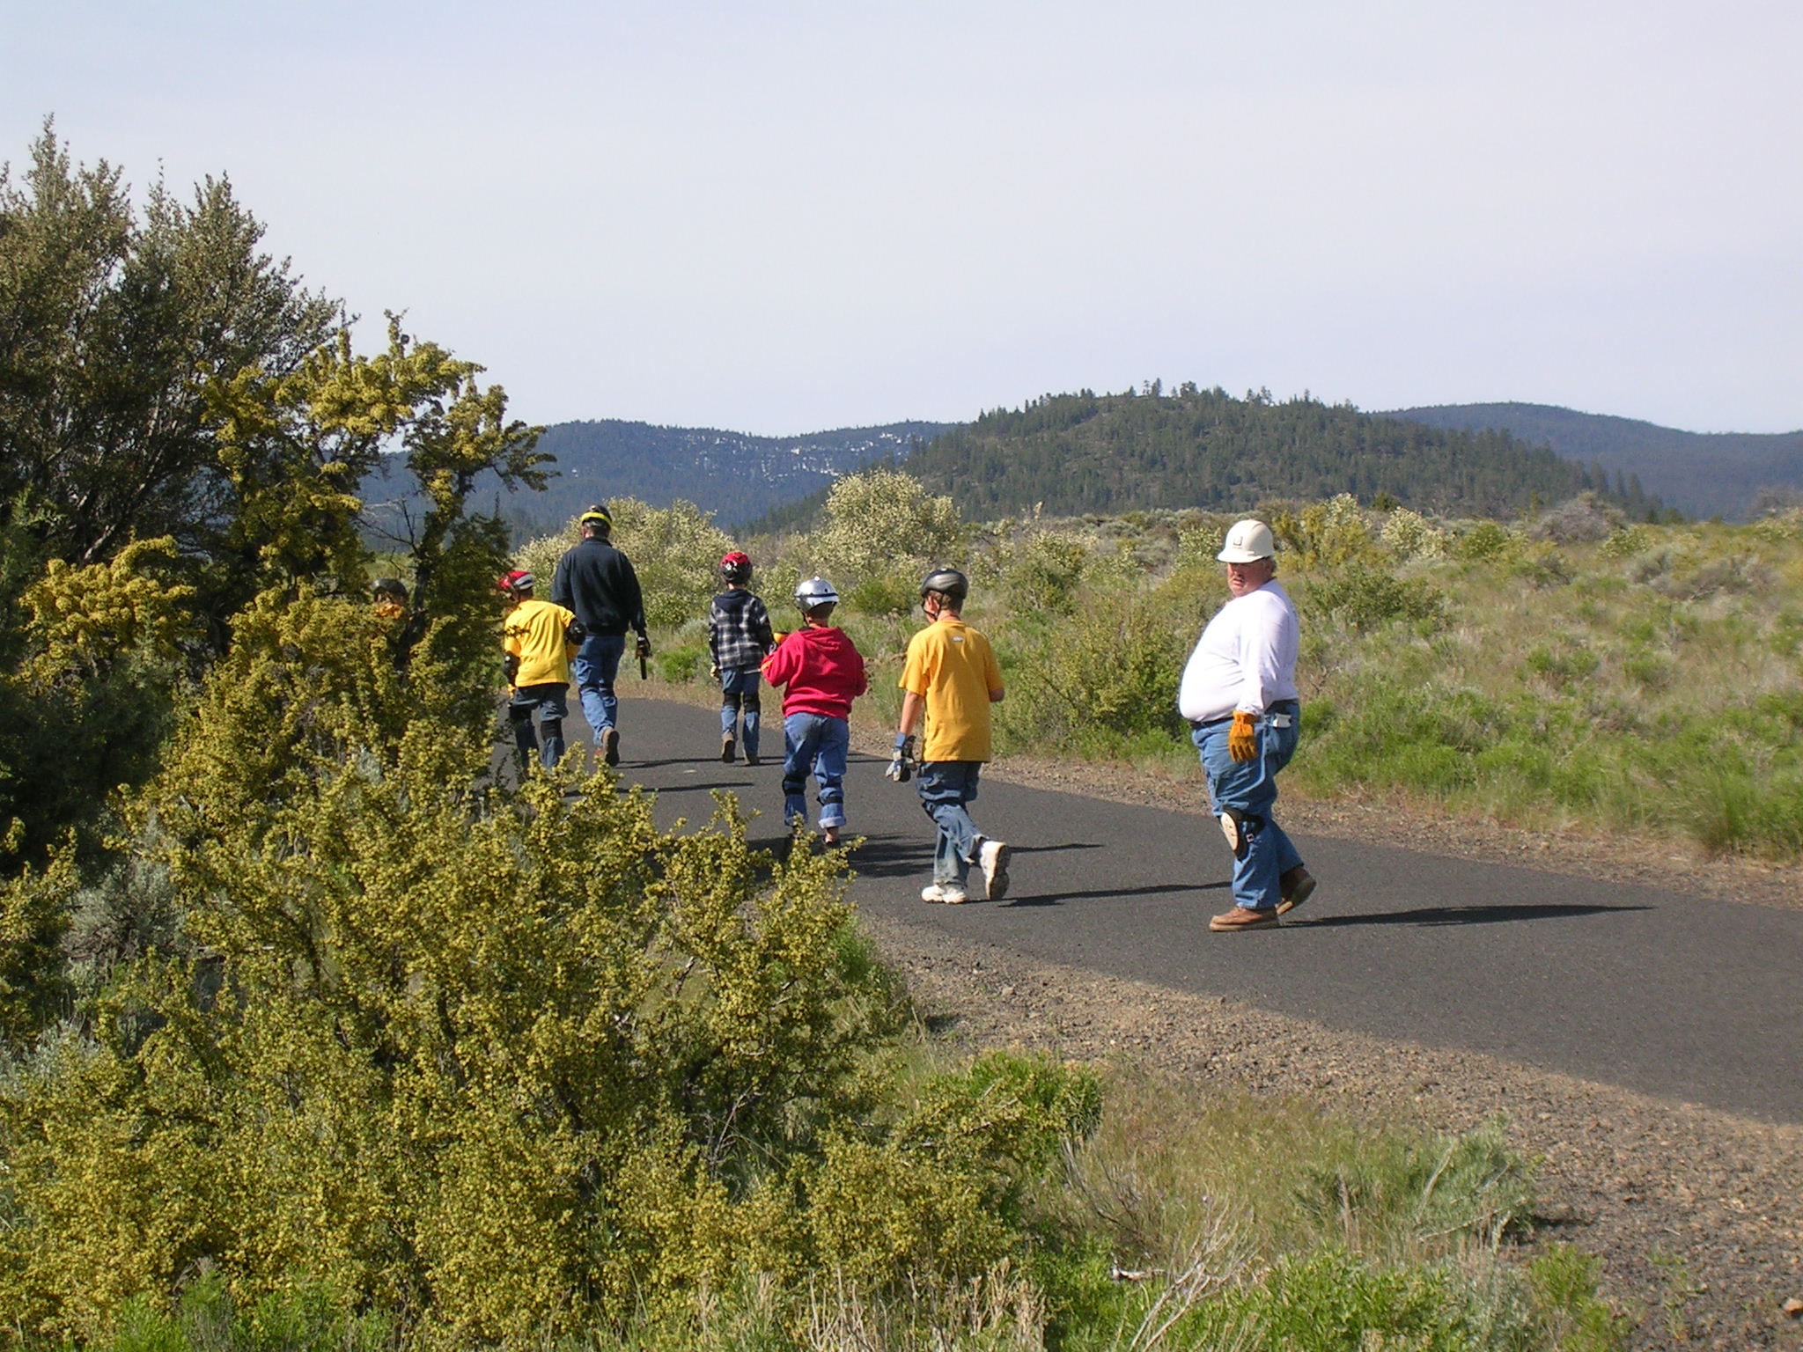
TOURISTS

Slide 15
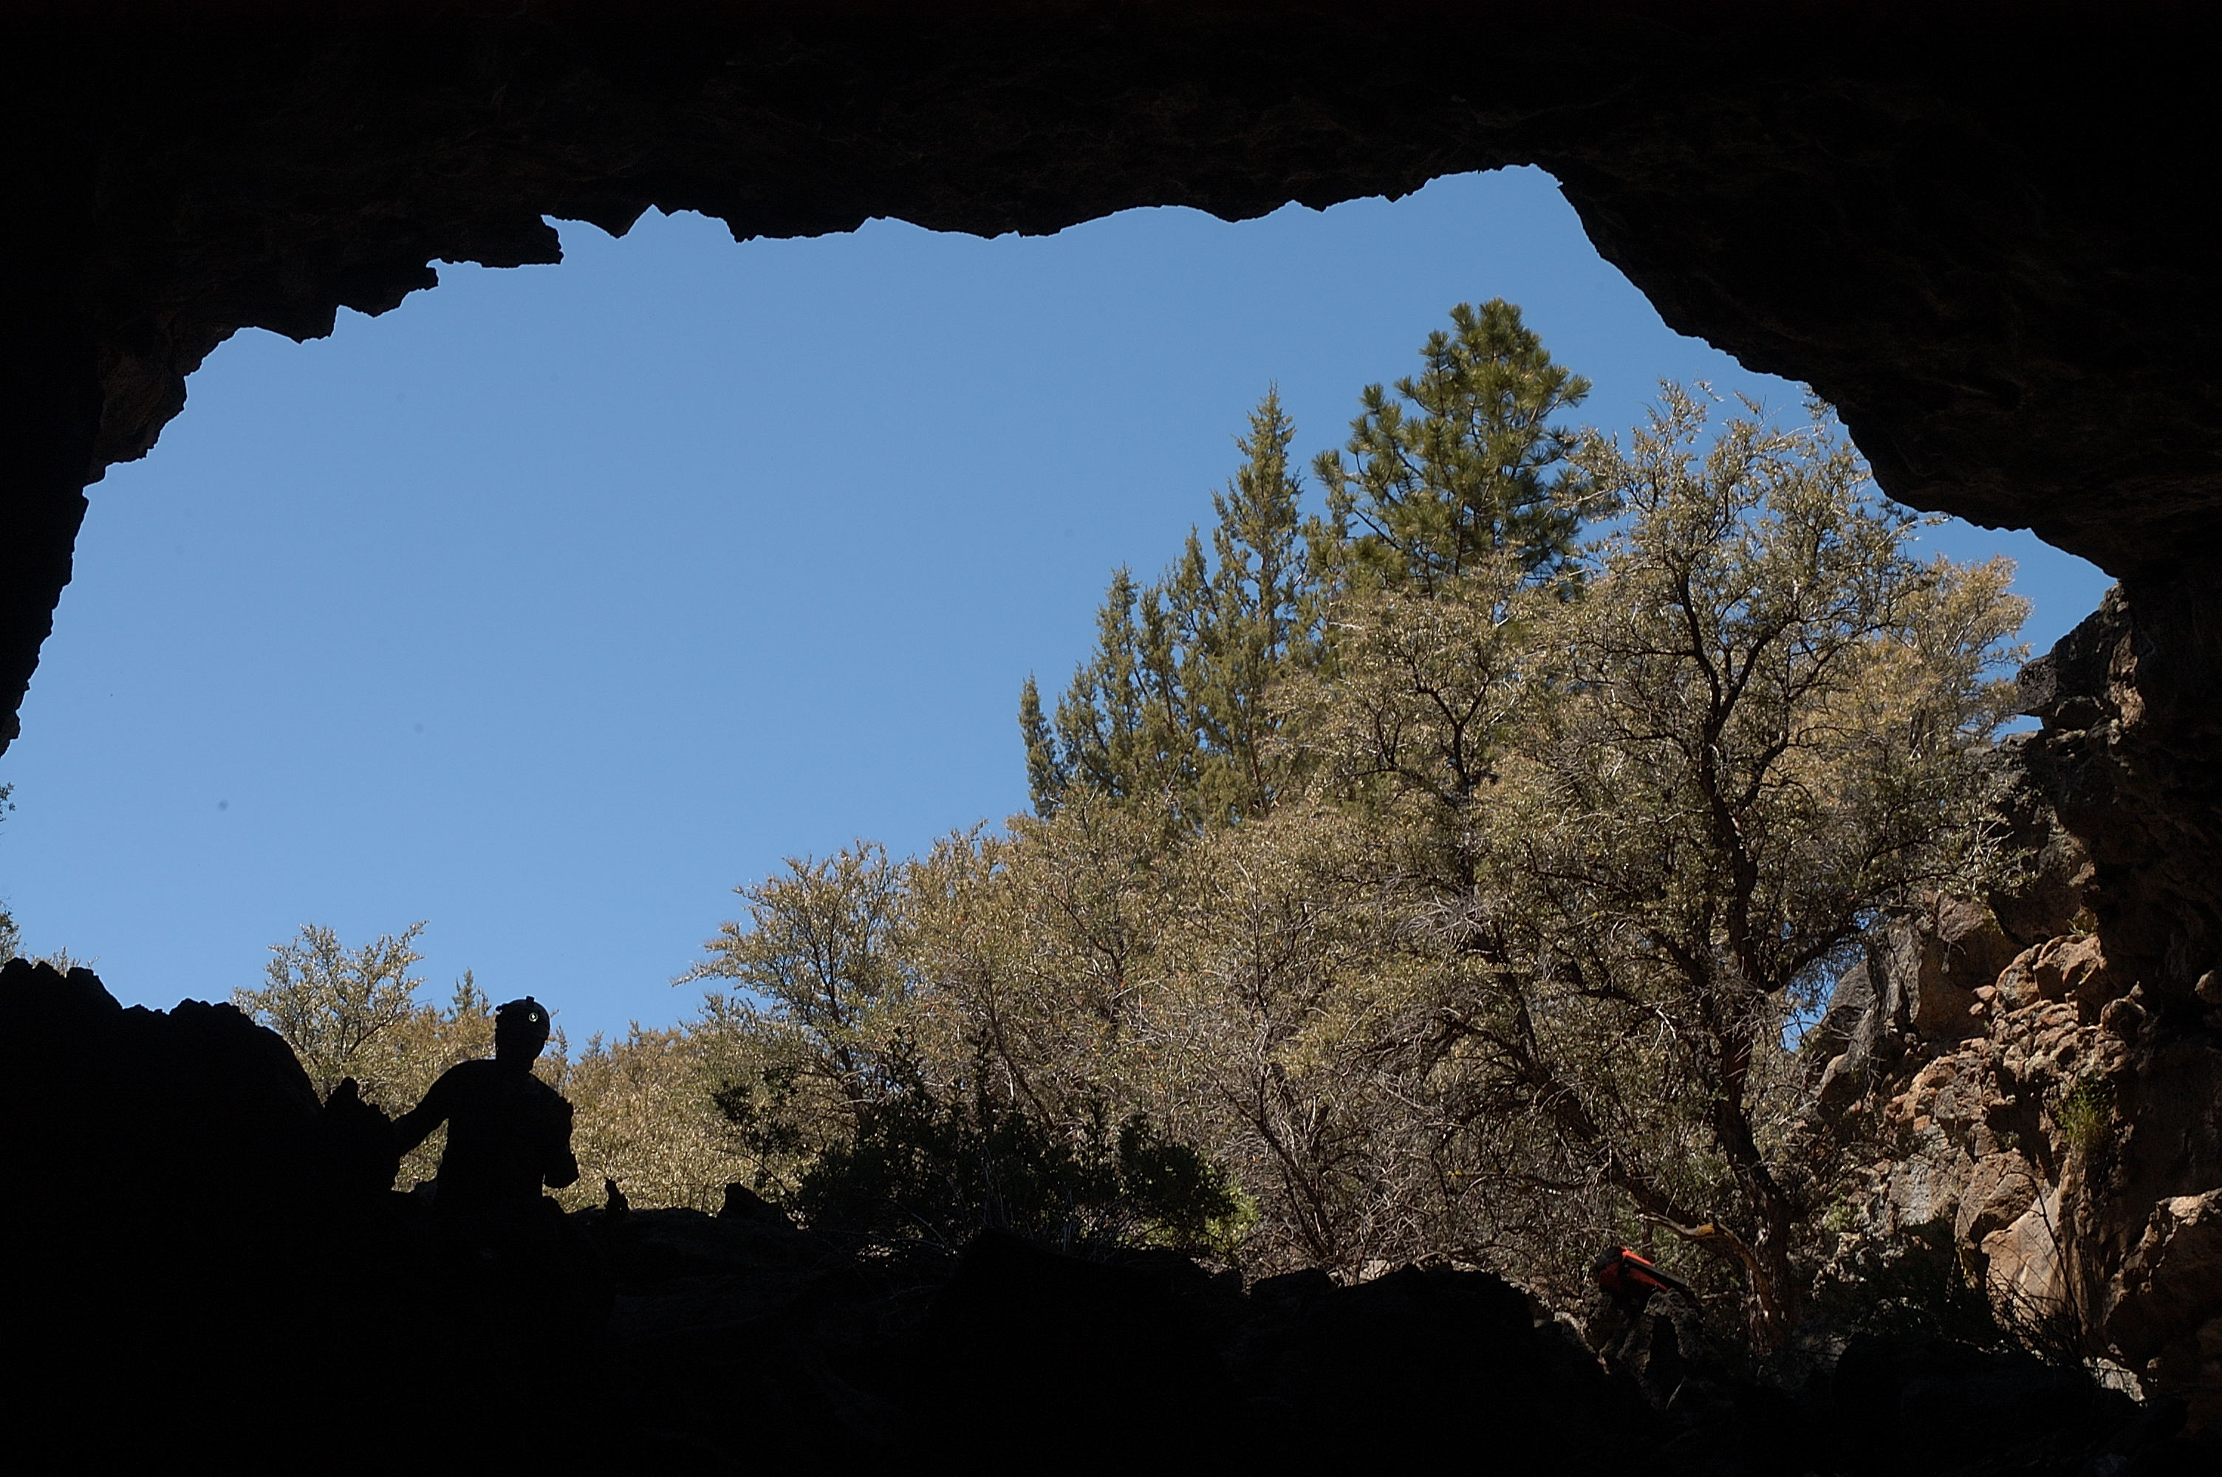
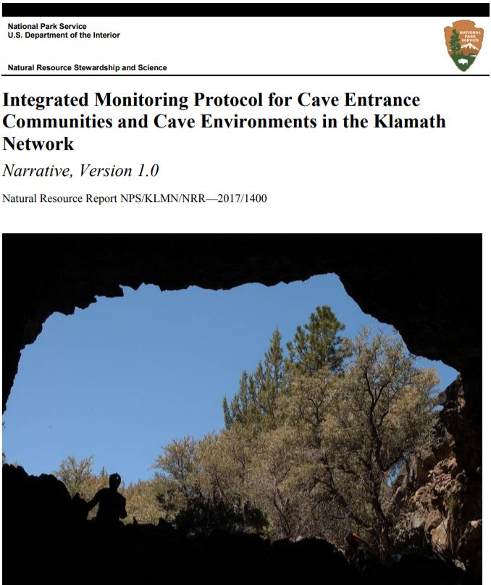
Management Plan:
Caldwell Ice Cave

Slide 16
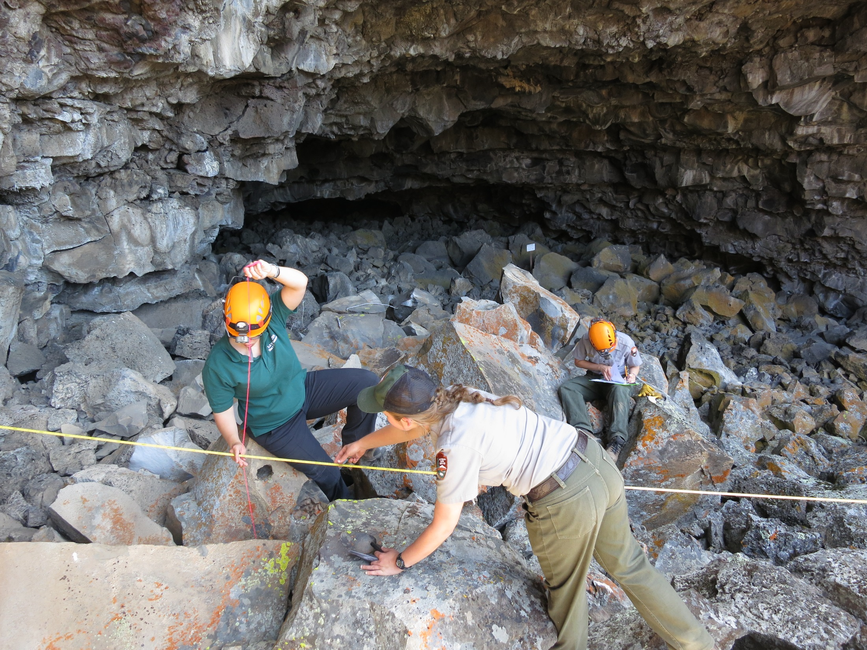

Slide 17
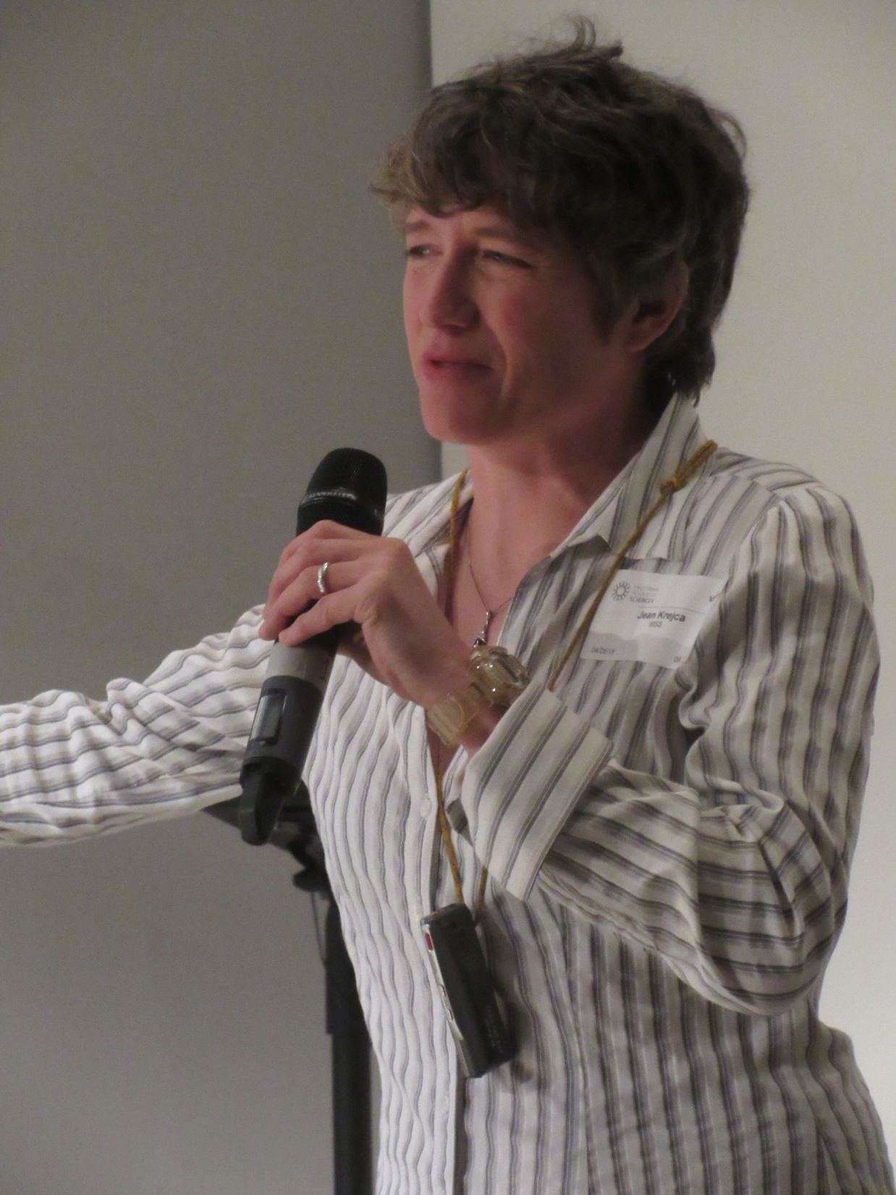

Slide 18
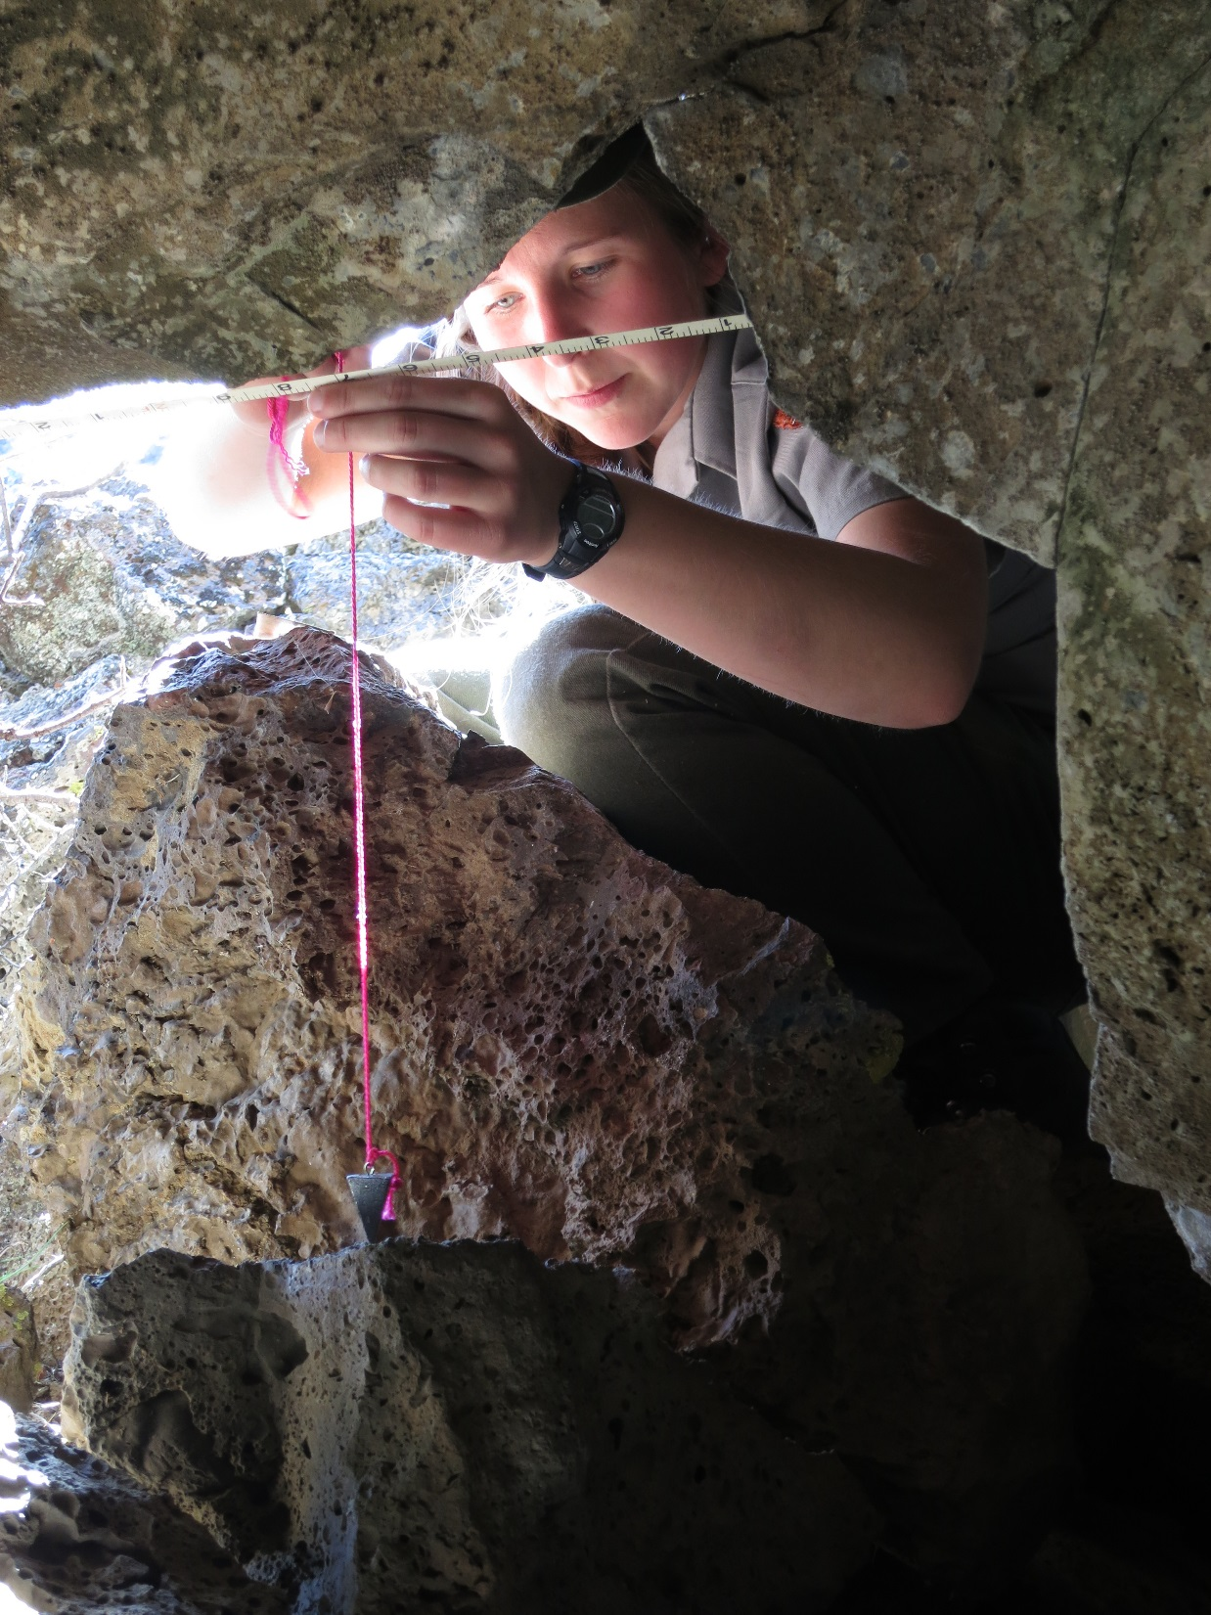

Slide 19
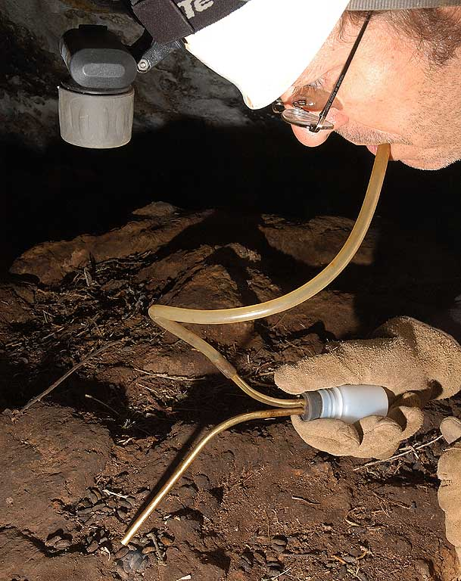
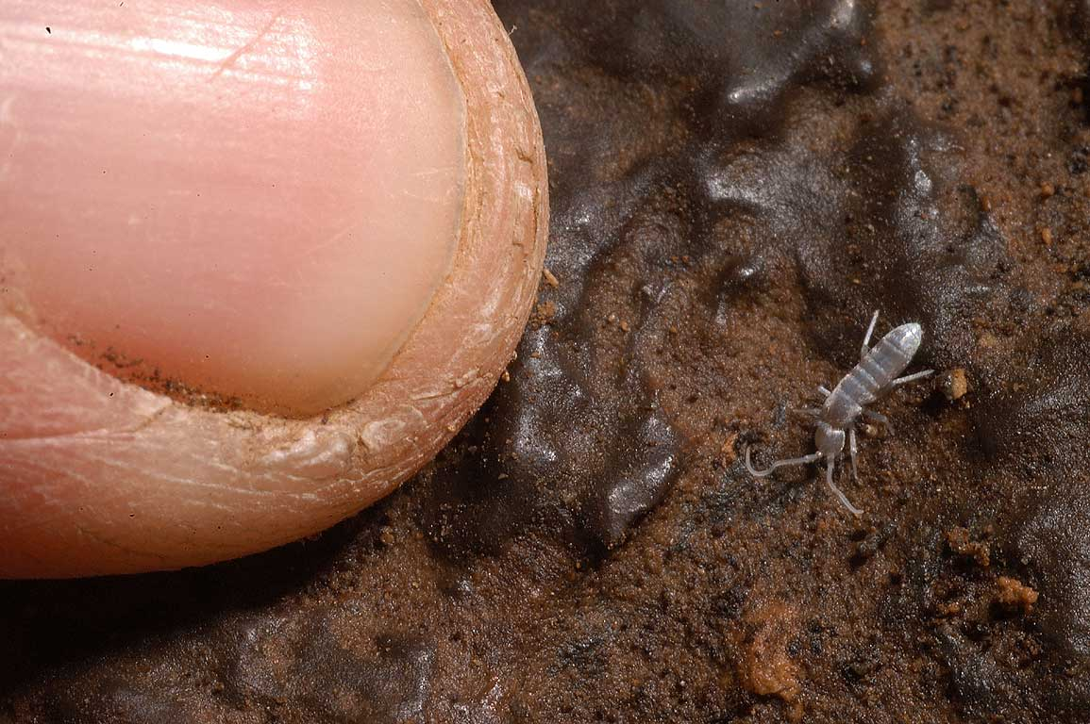
Interesting factoid
To take home to
The family:
Collecting miniscule
Invertebrates with
aspirator
Rollercoaster Cave,
Lava Beds
National Monument
Notes:
Photographs and powerpoint slides are Copyright © 2005 by Steven J. Taylor and Jean K. Krejca
Permission for one time use only, and only with written permission from copyright holders.

Slide 20
Caves formed in MARBLE
Sequoia and Kings Canyon National Parks

Slide 21
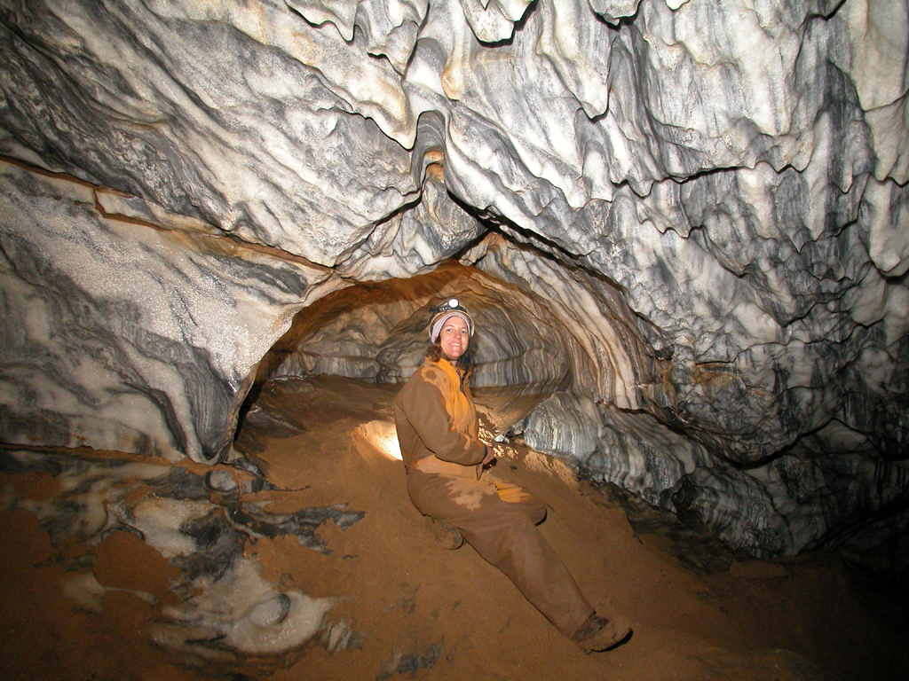

Slide 22
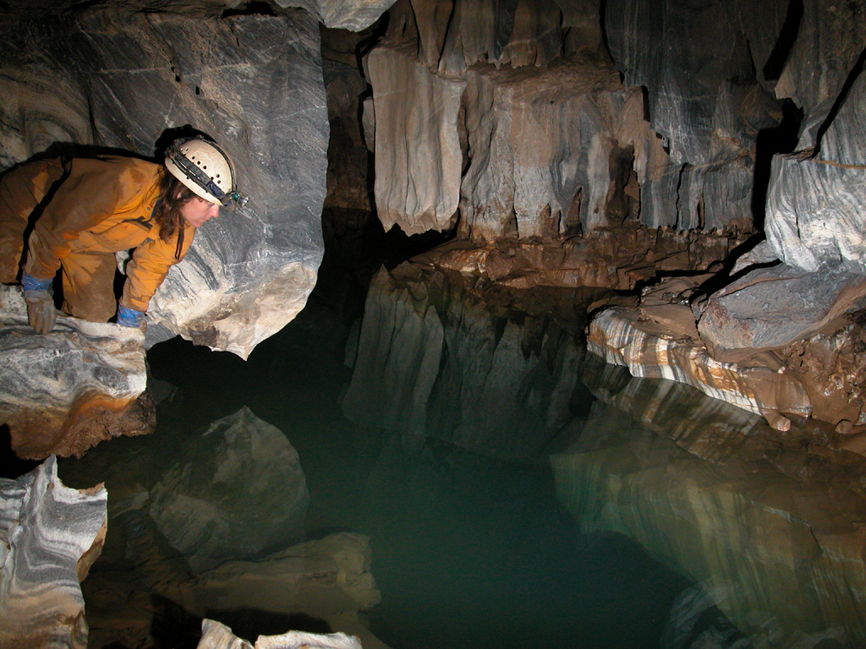

Slide 23
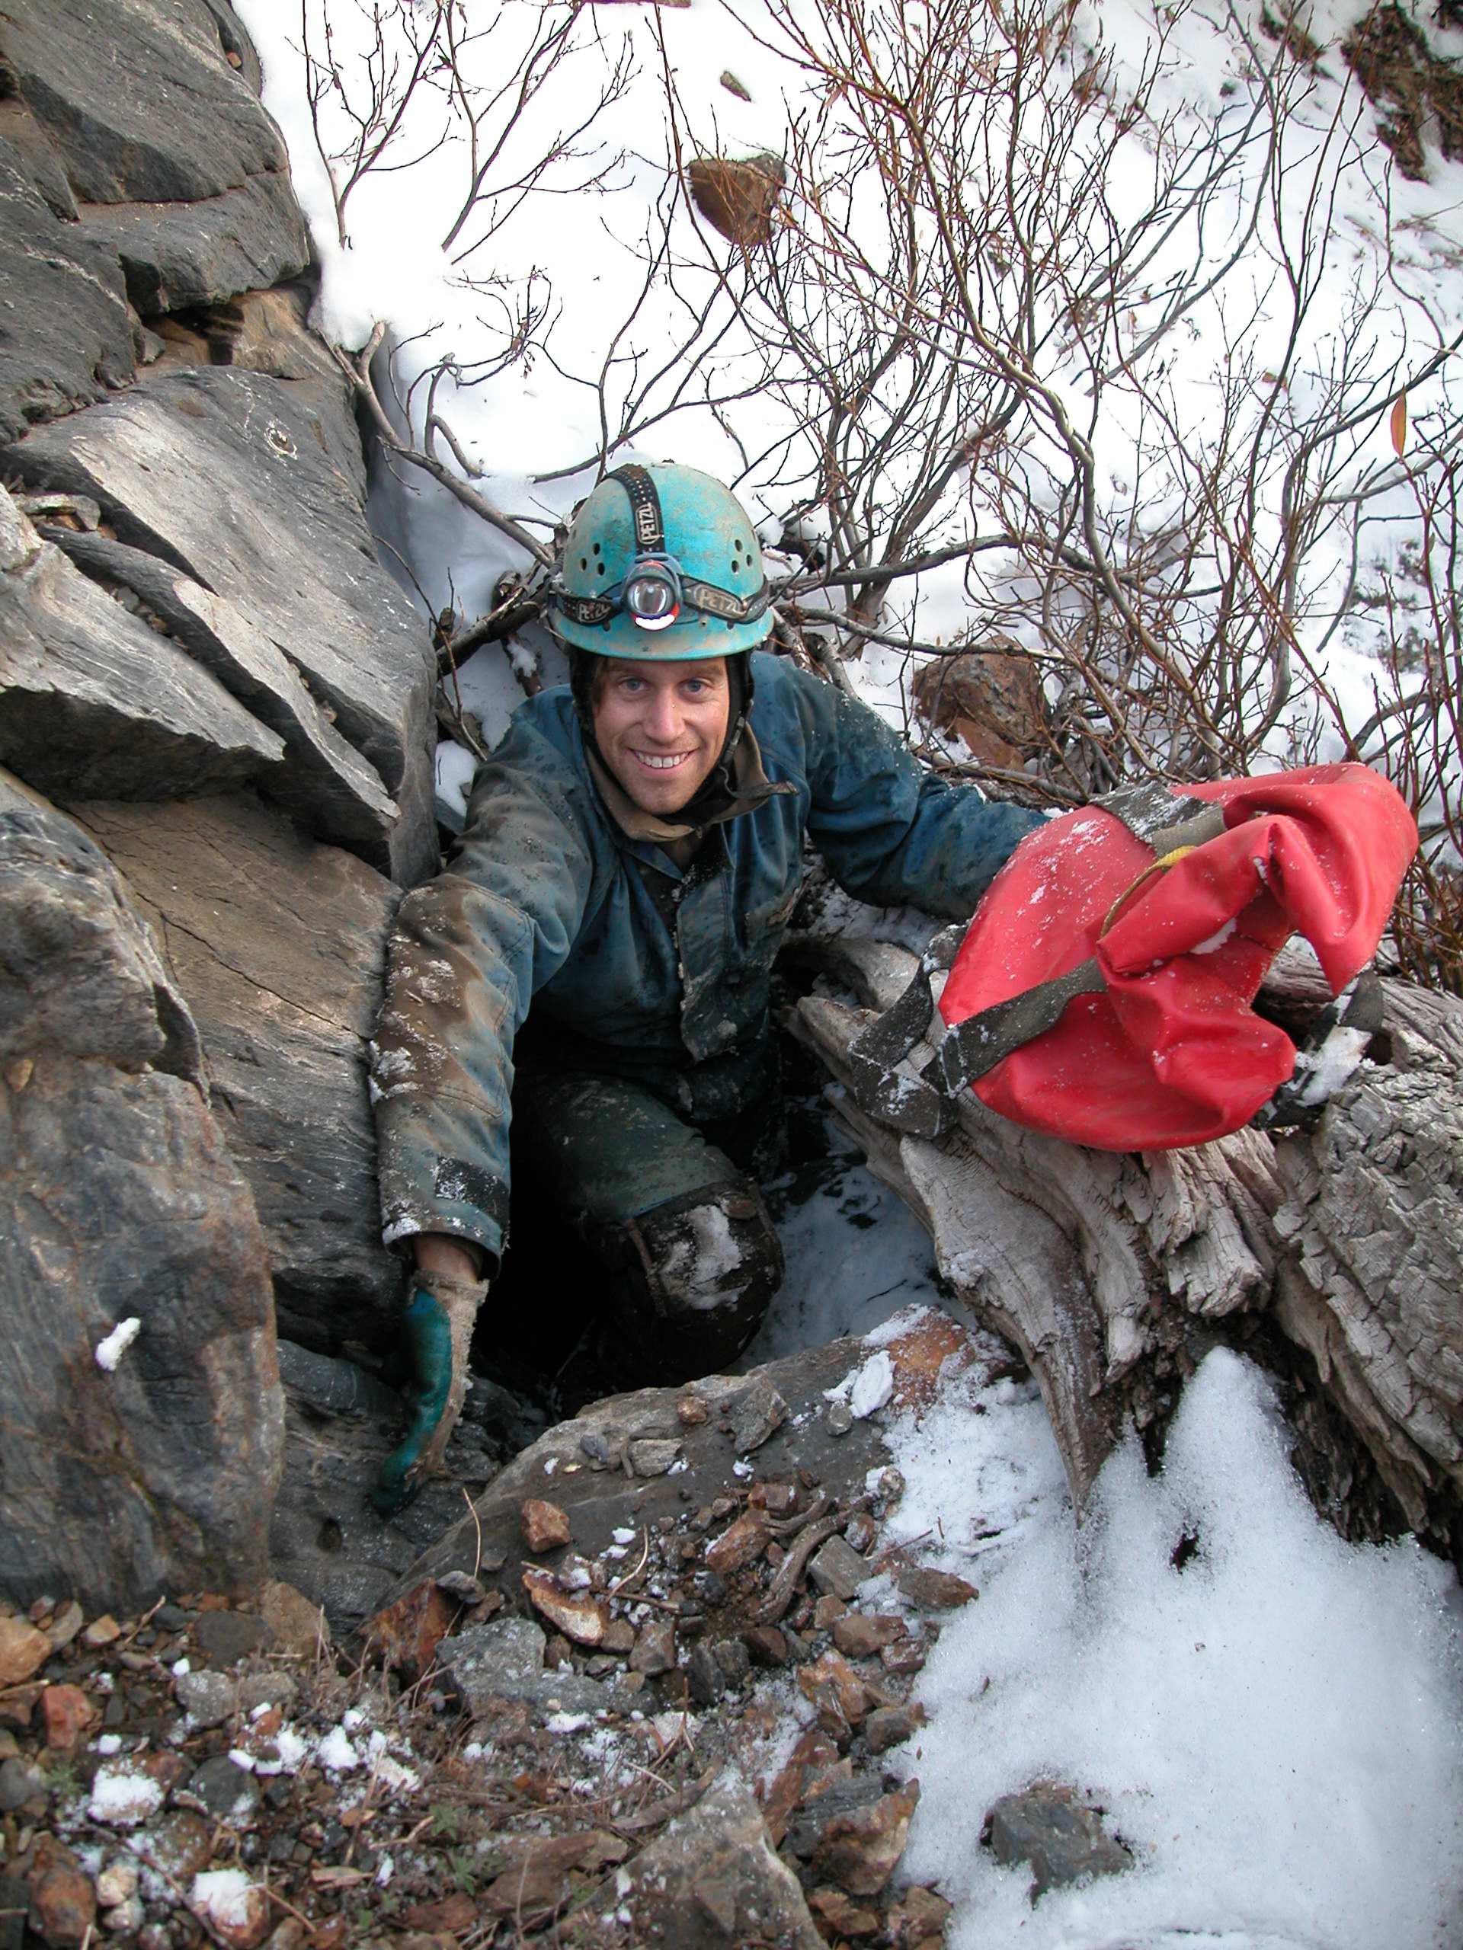
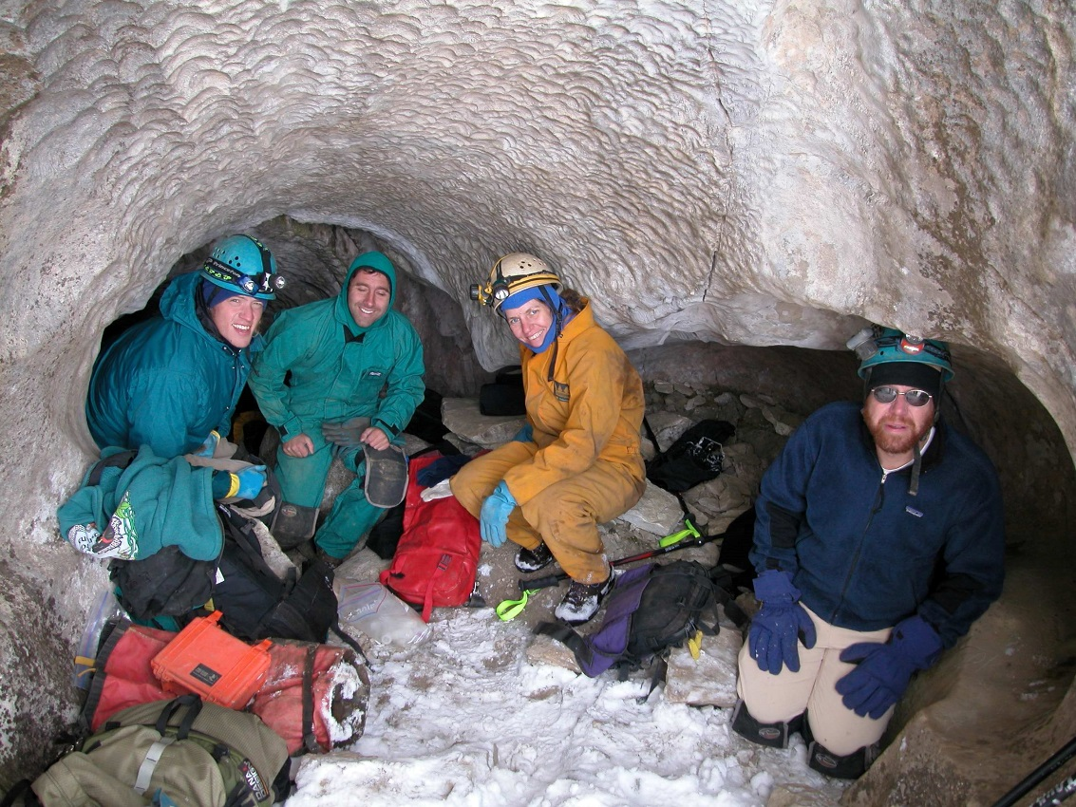
Multi-year grant supported teams of cave specialists and invertebrate biologists

Slide 24
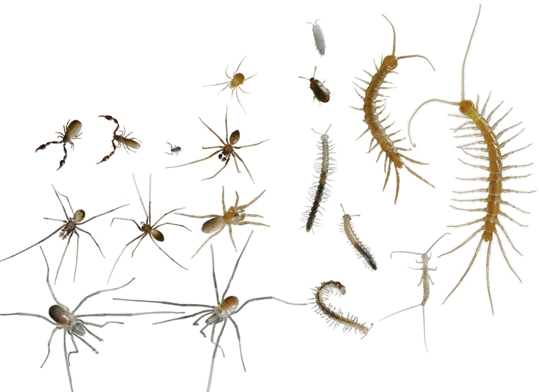
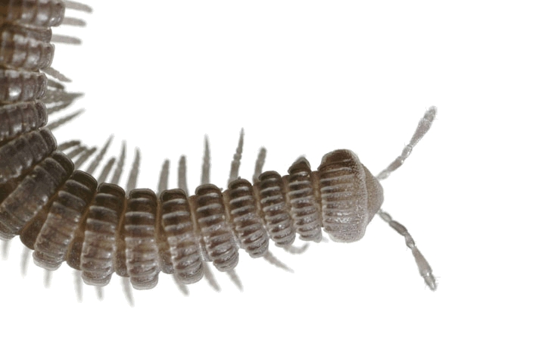
Interesting factoid
To take home to
The family:
2007 Nat Geo article highlights 27 new species!
Article By Kevin Krajick, Photographs by David Liittschwager
Notes:
Photographs and powerpoint slides are Copyright © 2005 by Steven J. Taylor and Jean K. Krejca
Permission for one time use only, and only with written permission from copyright holders.

Slide 25
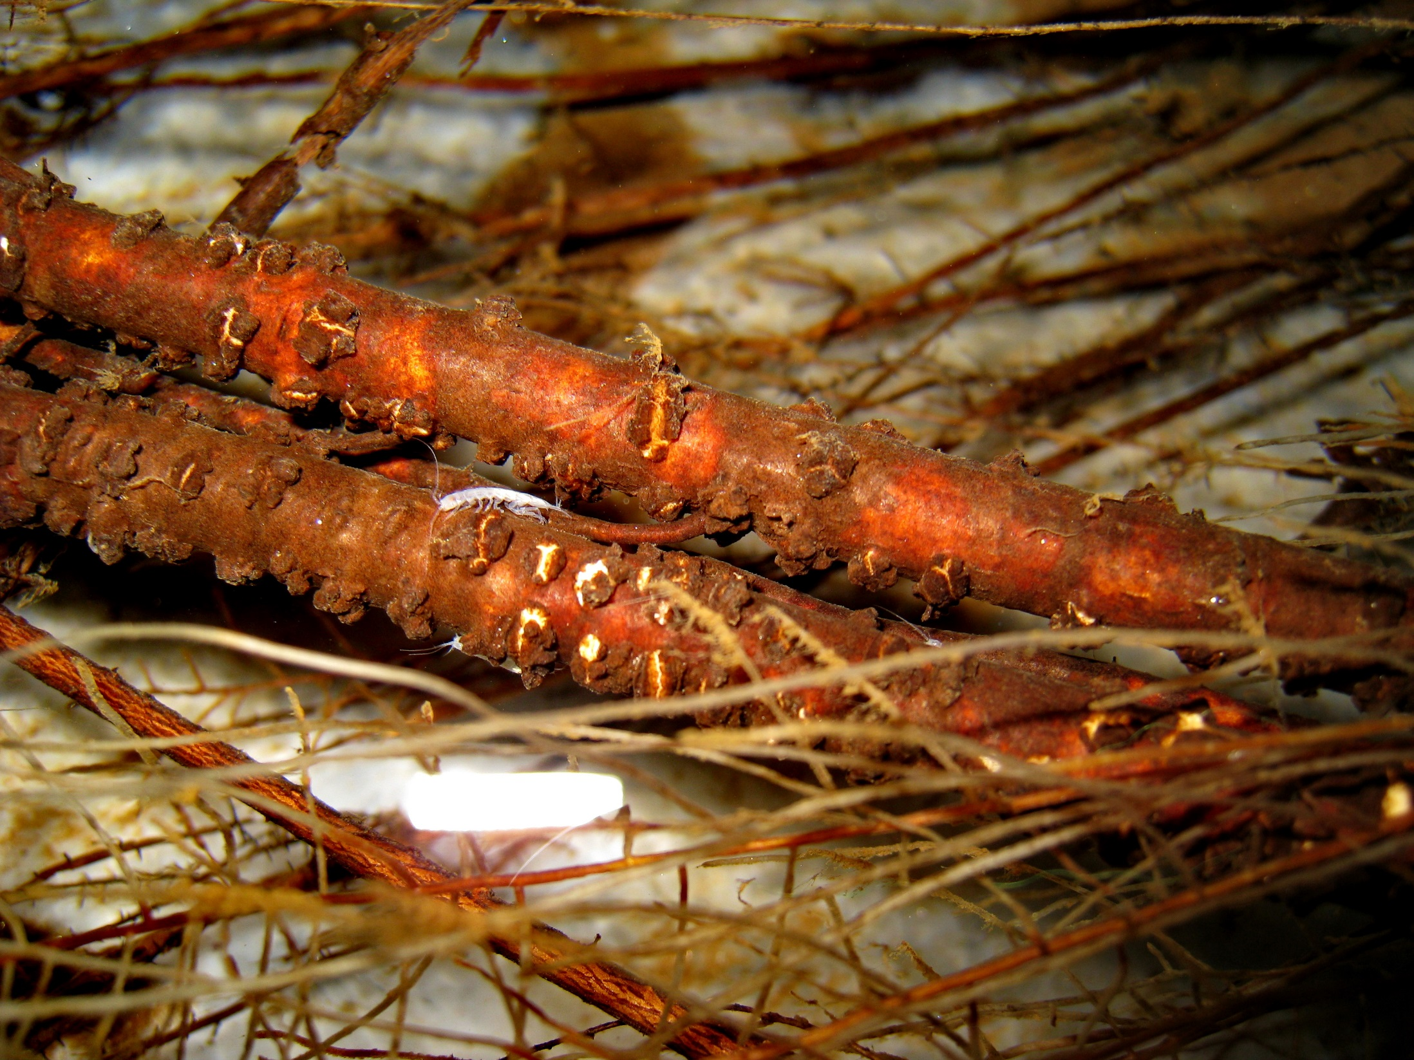
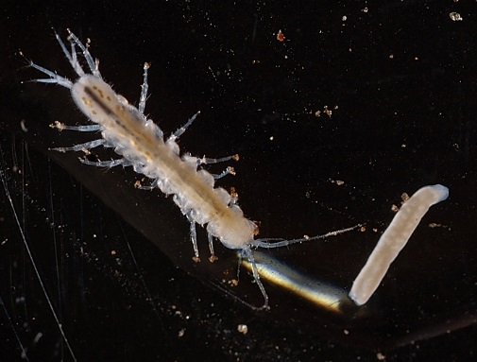
Bowmanasellus sequoiae

Slide 26
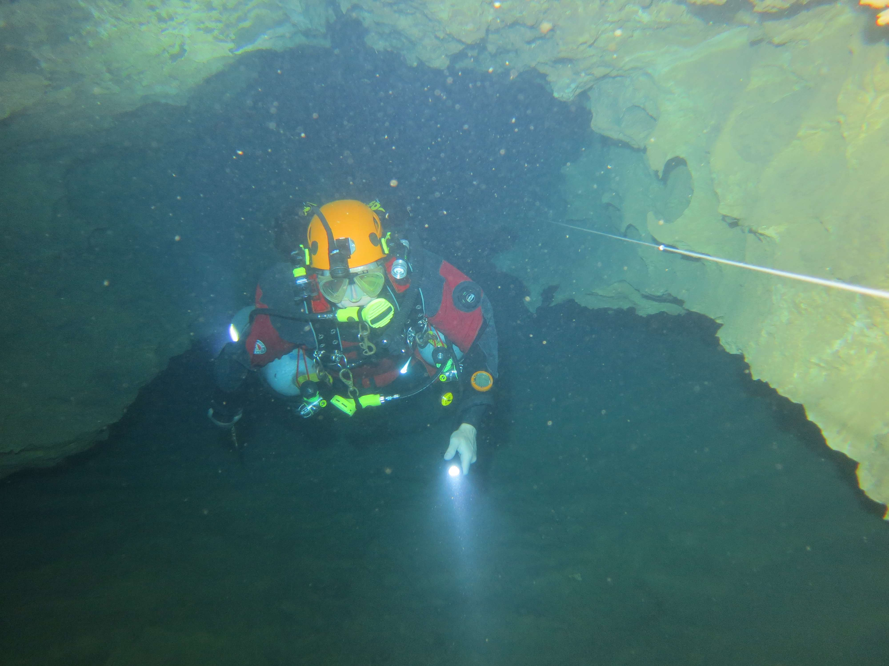
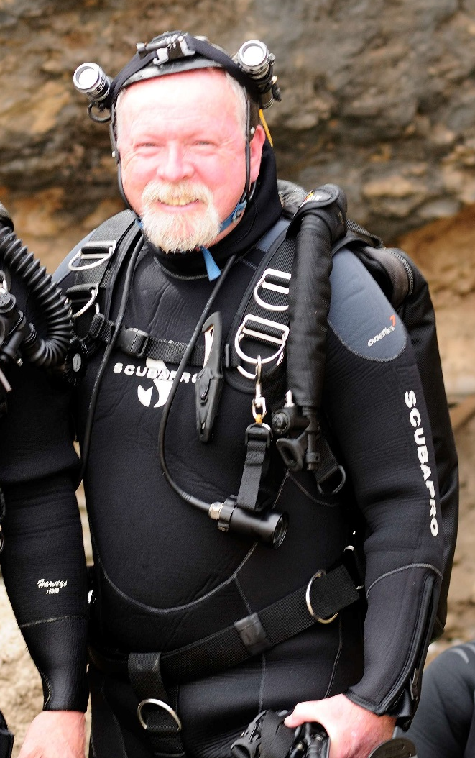
Cave divers James Brown and Tom Iliffe discovered a new locality for this species in Big Springs (Bowmanasellus sequoia)

Slide 27
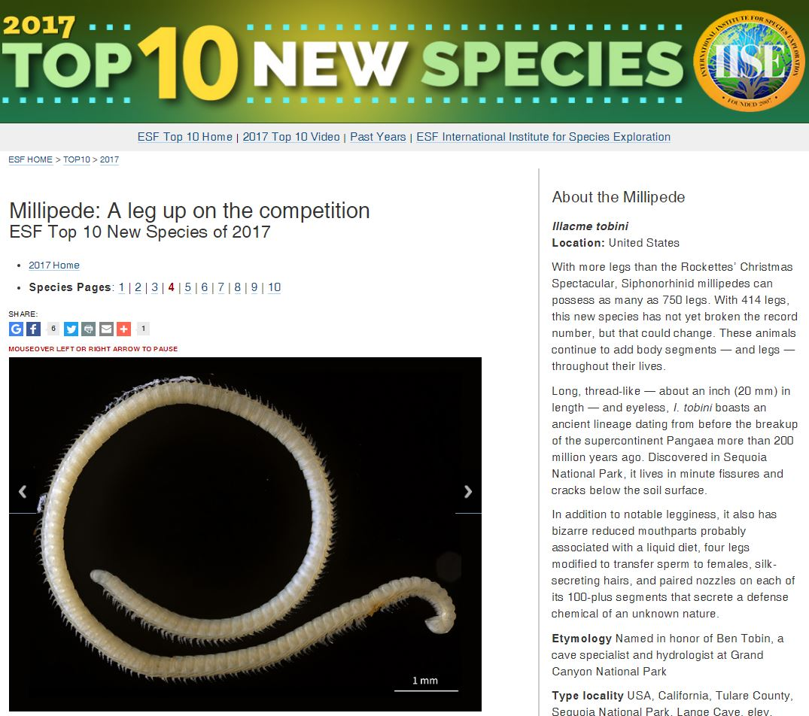
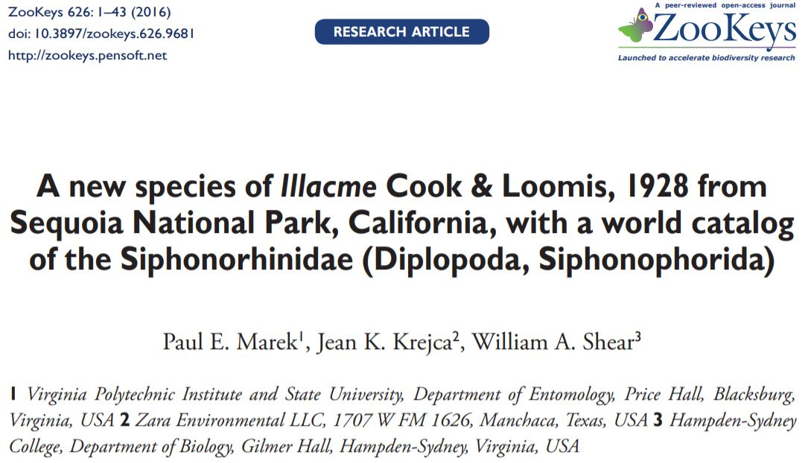

Slide 28
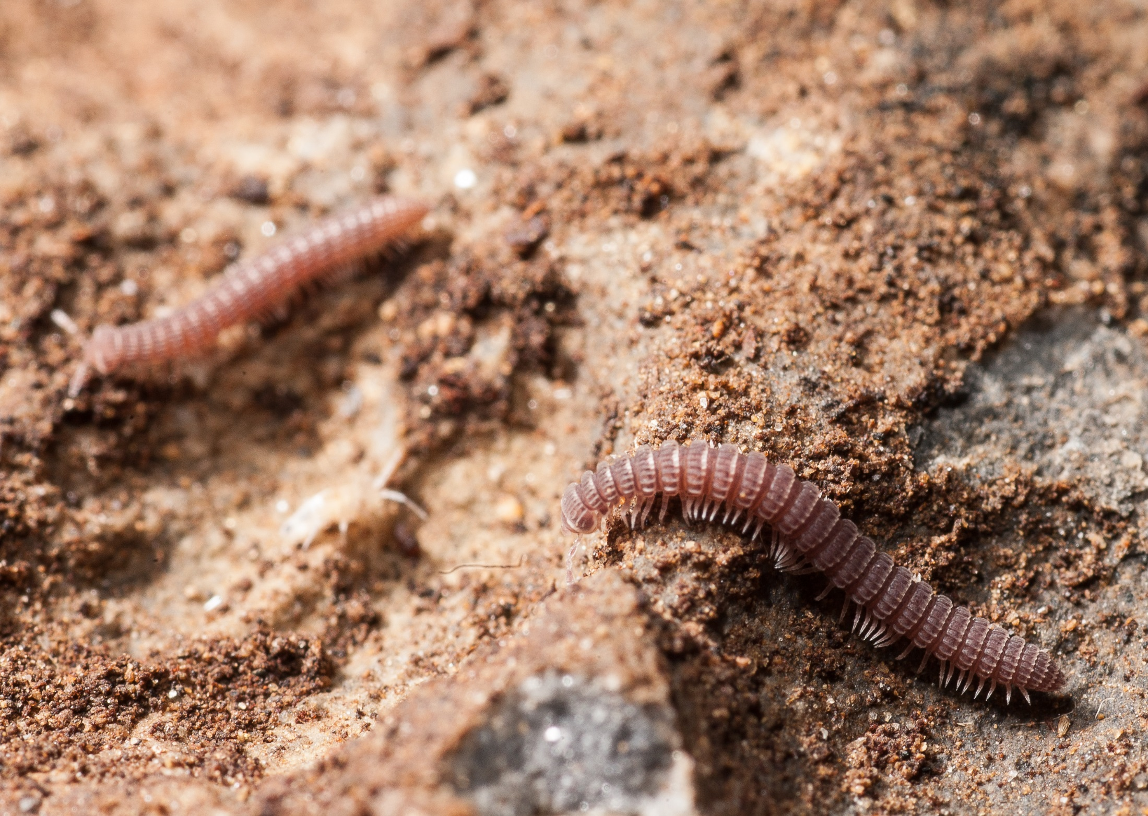
Amplaria adamsi

Slide 29
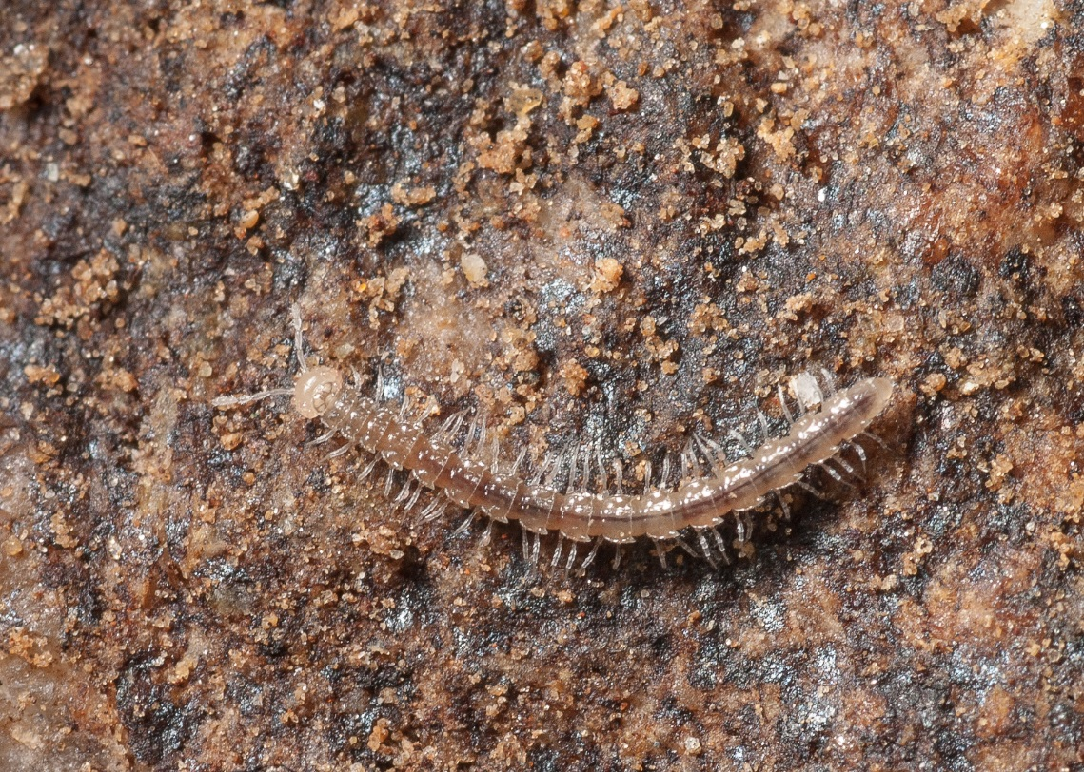
Pratherodesmus despaini

Slide 30
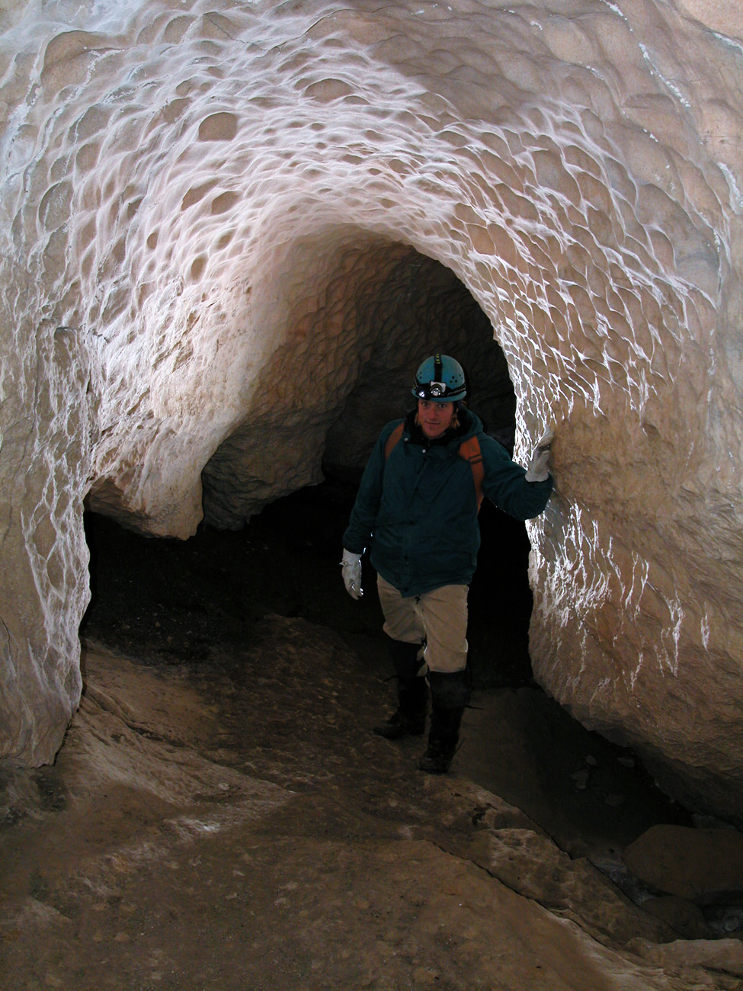
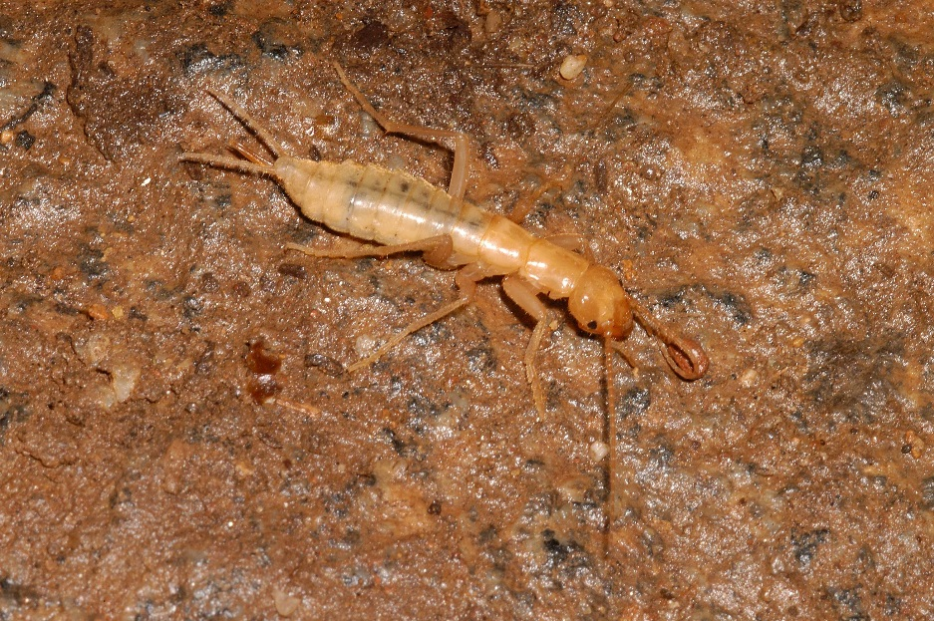
Gryloblattid: Ice Crawler
Preferred temp: 1-4 C
(34-39 F)
Whitechief Cave

Slide 31
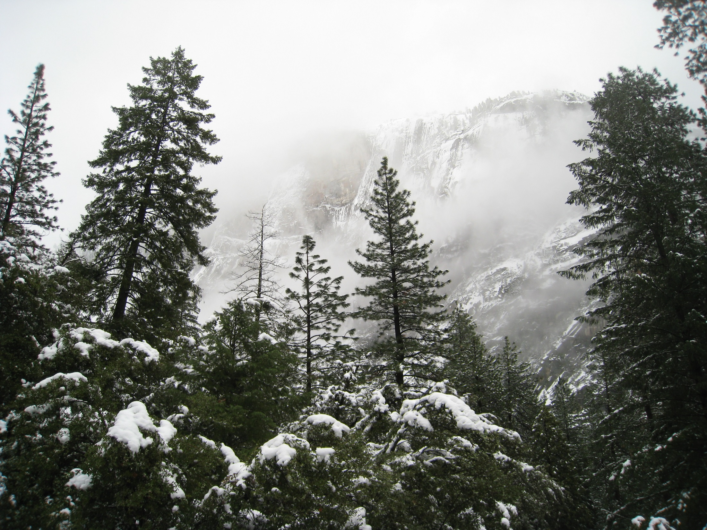
Yosemite National Park

Slide 32
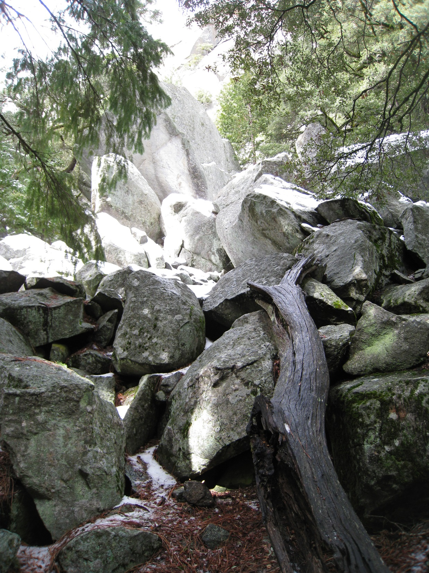
Caves formed in TALUS

Slide 33
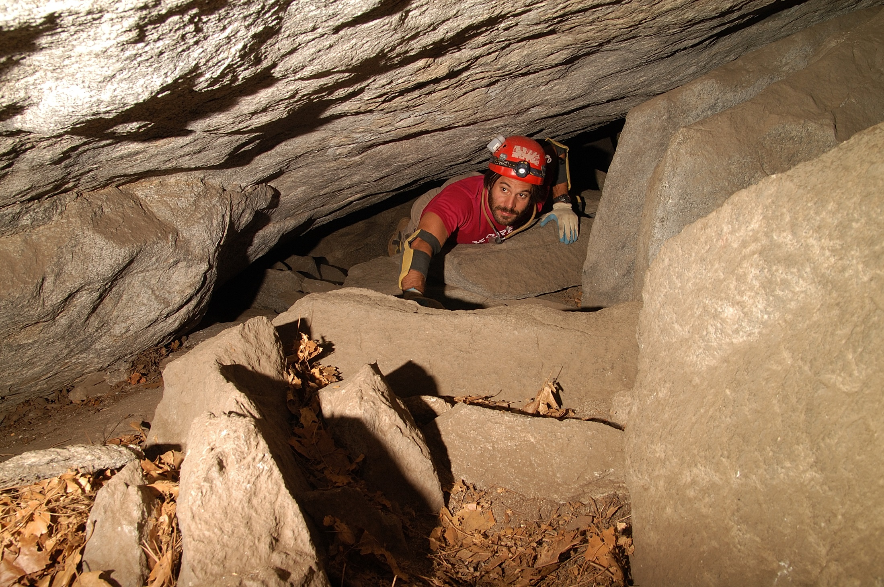

Slide 34
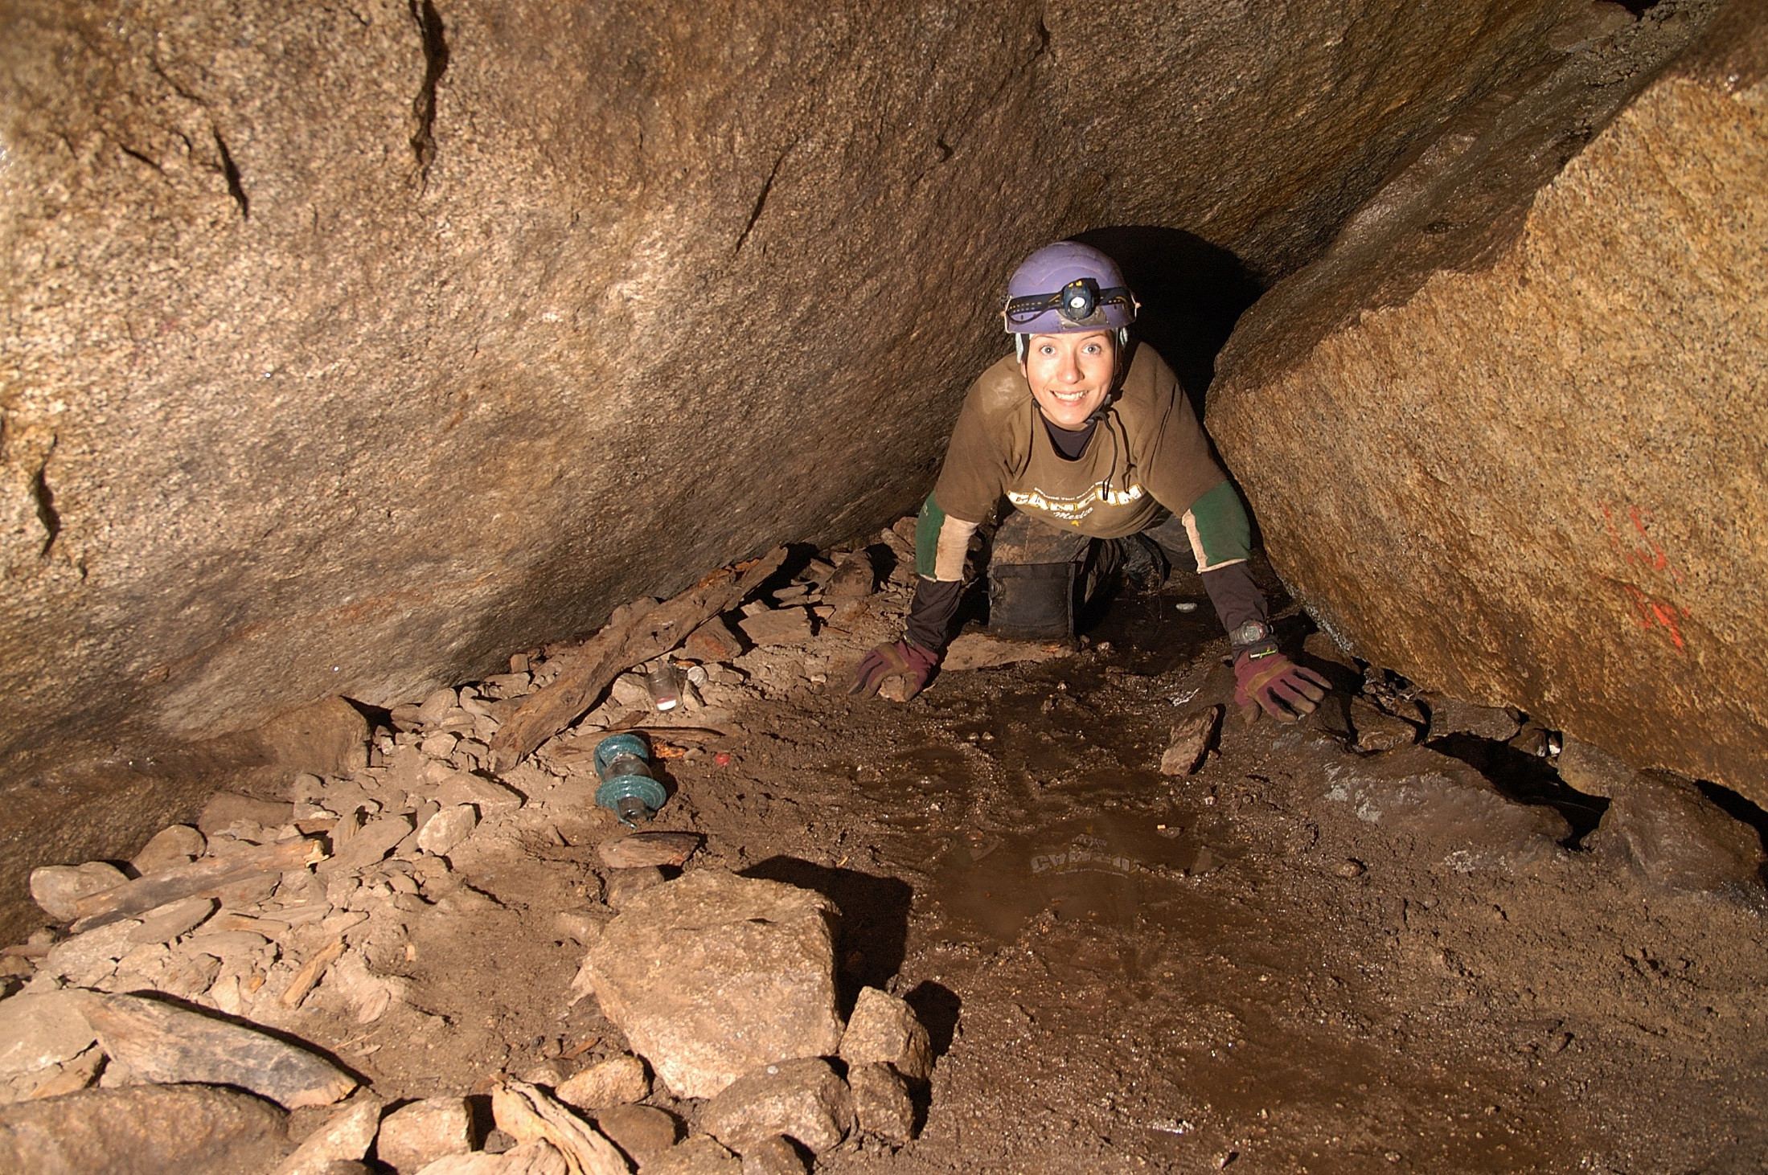

Slide 35
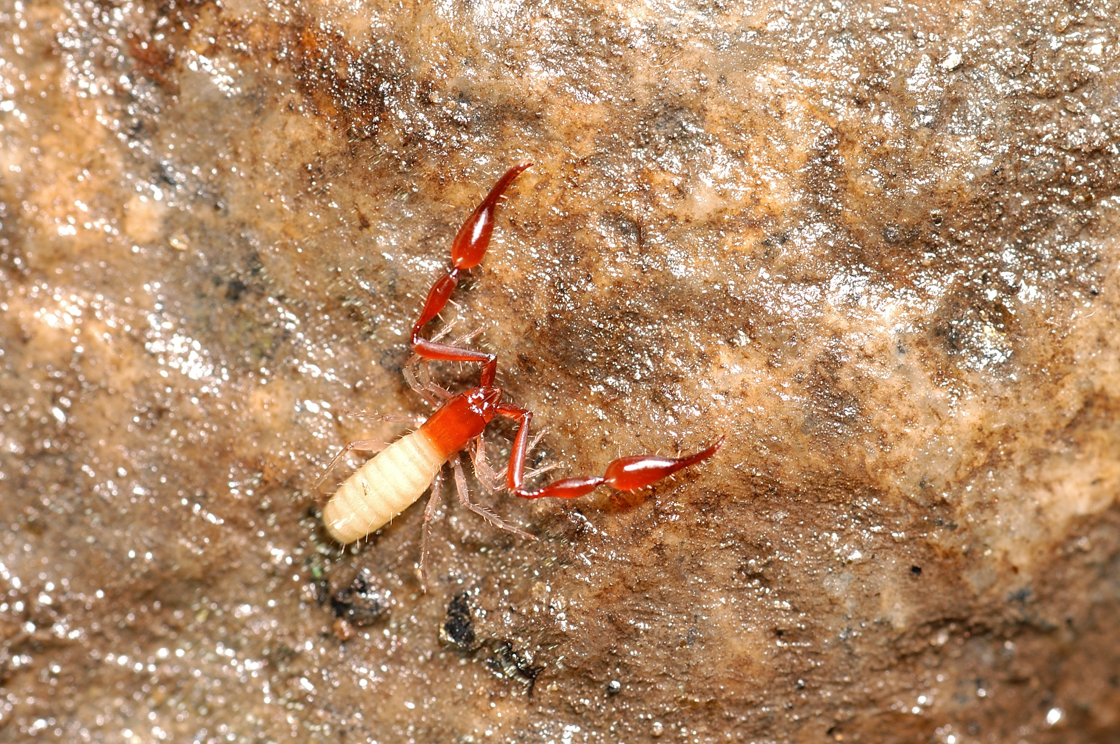
New Species Parobisium yosemite

Slide 36
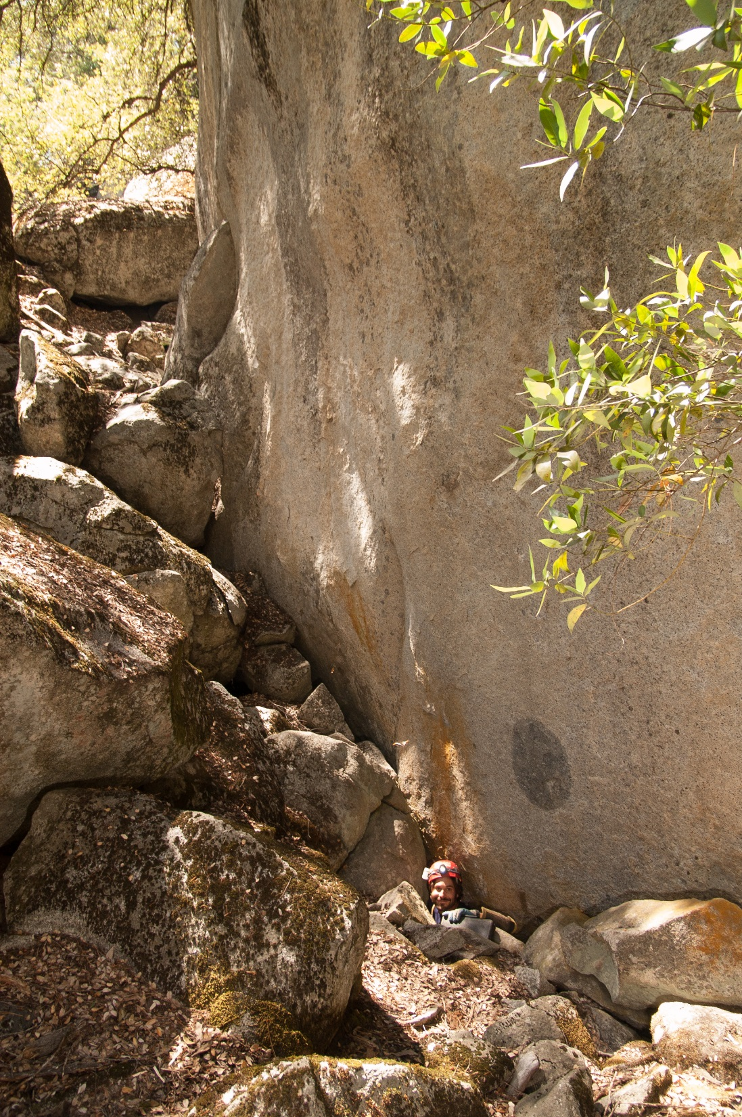
Interesting factoid
To take home to
The family:
Not all rockfall in Yosemite Valley is bad!

Slide 37
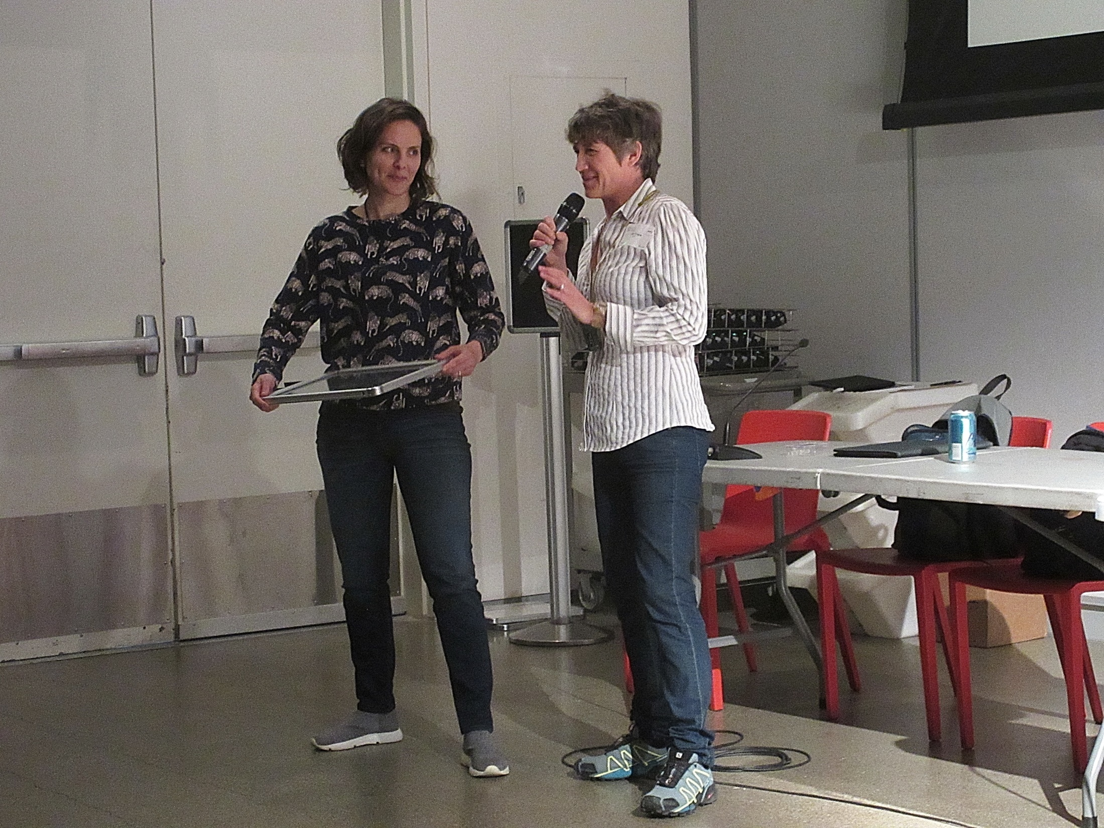

Slide 38
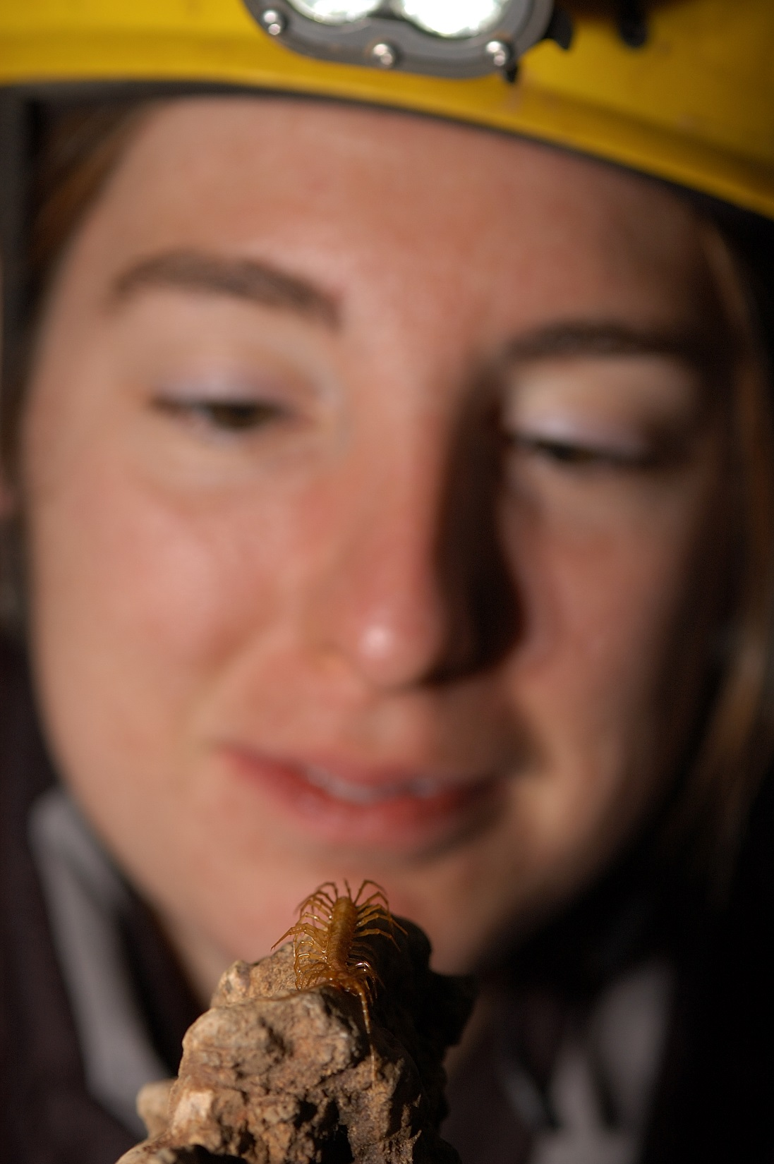
Thanks!
(and remember, cave invertebrates are cool)

