Slide 1
San Francisco

Slide 2
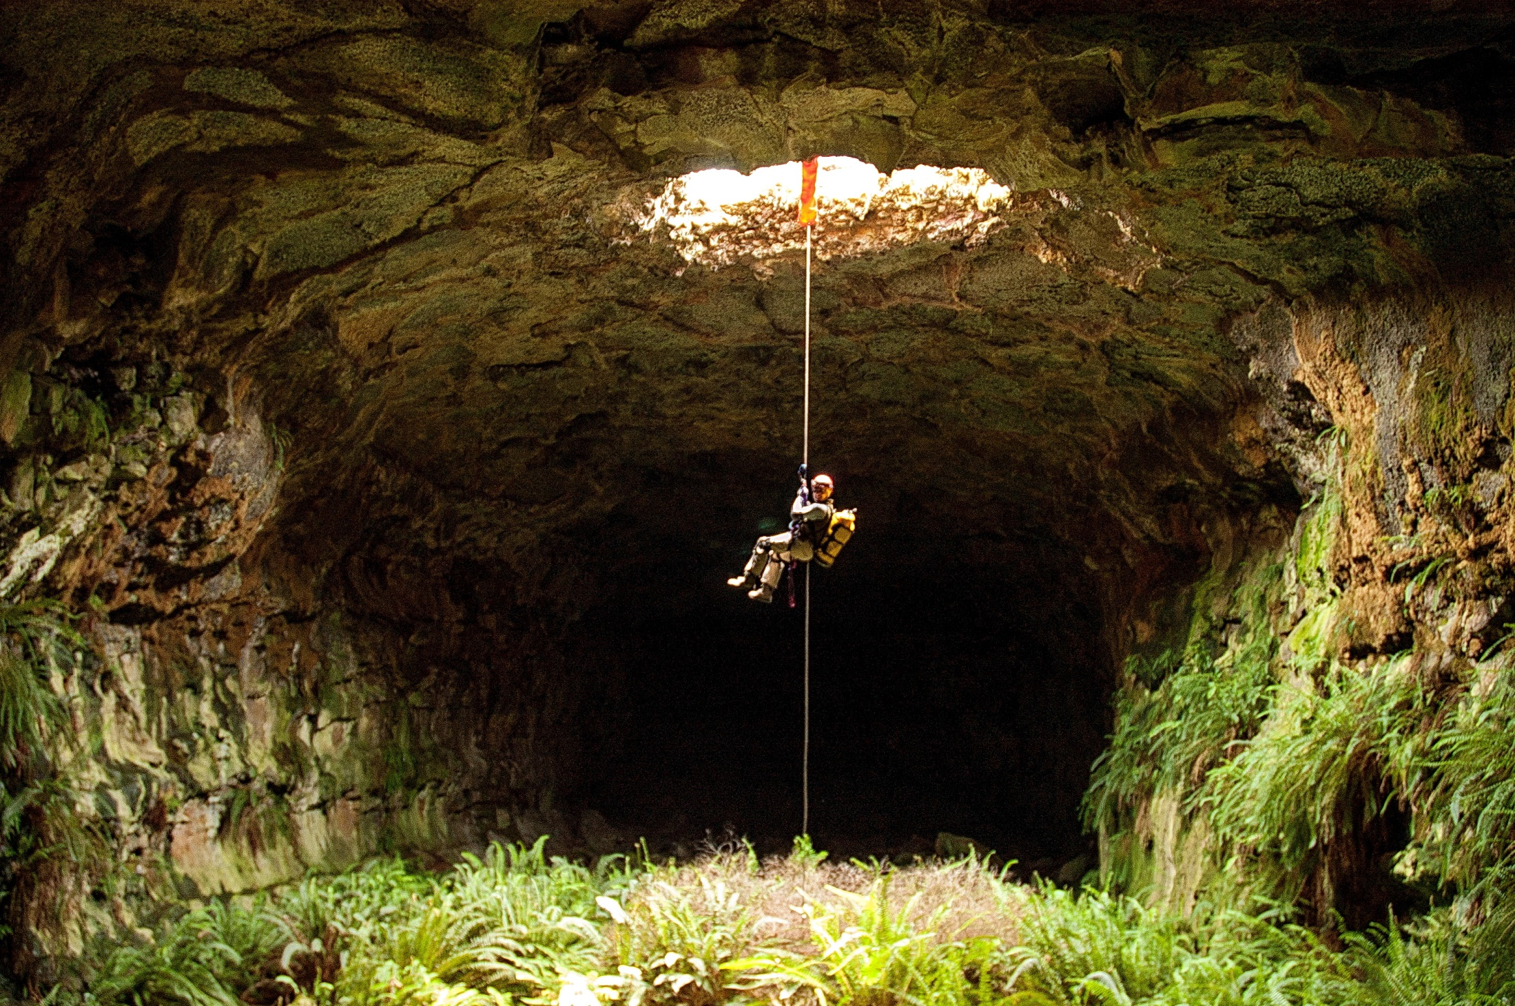
California Cave Life Symposium
Saturday, April 28, 2018, 10 am – 4 pm, Forum Theatre
Fossil Cave,
Lava Beds NM

Slide 3
A series of 9 slide talks by William R. Elliott, Geo Graening, Darrell Ubick, Rolf Aalbu, Jean Krejca & Steve Taylor, D. Craig Rudolph, Tom Rickman & Barb Andrews. With a book signing and panel discussion.
Lilburn Cave,
Kings Canyon NP

Slide 4
The Symposium was based on this 311-page book, which is available as a free pdf at:
http://cavelife.info/
and at:
http://researcharchive.calacademy.org/research/izg/SciPubs2.html
Printed copies for sale at:
kpiatek@calacademy.org
and:
http://www.speleobooks.com/

Slide 5
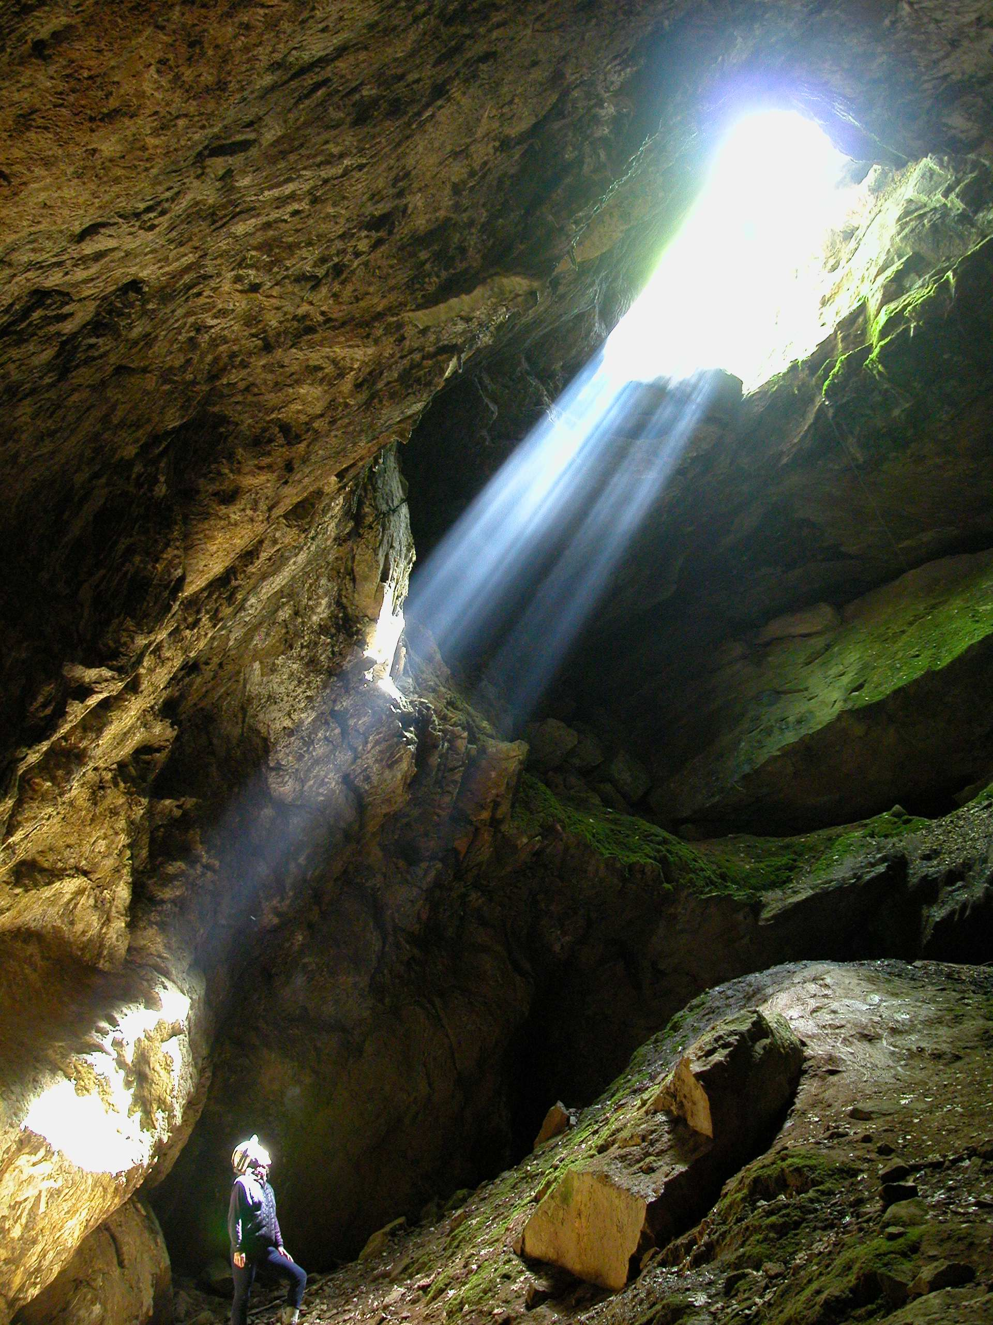
All material and images are copyrighted by the speakers and photographers, ©2018.
These slide shows are intended for free educational use. No re-use for sale or reformatting is allowed without written permission.
Palmer Cave,
Sequoia NP

Slide 6
Thanks to the photographers:
Rolf Aalbu, Kym Abrams, Jessica Blois, Peter Bosted, Dave Bunnell, Stan Cunningham, Joel Despain, William R. Elliott, Marshal Hedin, Jean Krejca, Joel M. Ledford, Gary Nafis, D. Craig Rudolph, and Steven J. Taylor

Slide 7
Dr. Shannon Bennett

Slide 9
Dr. William R. Elliott

Slide 10
Next: Geo Graening, Introducing The Cave Fauna of California

