Slide 1
Dr. Rolf Aalbu
Beetles and Caves

Slide 2
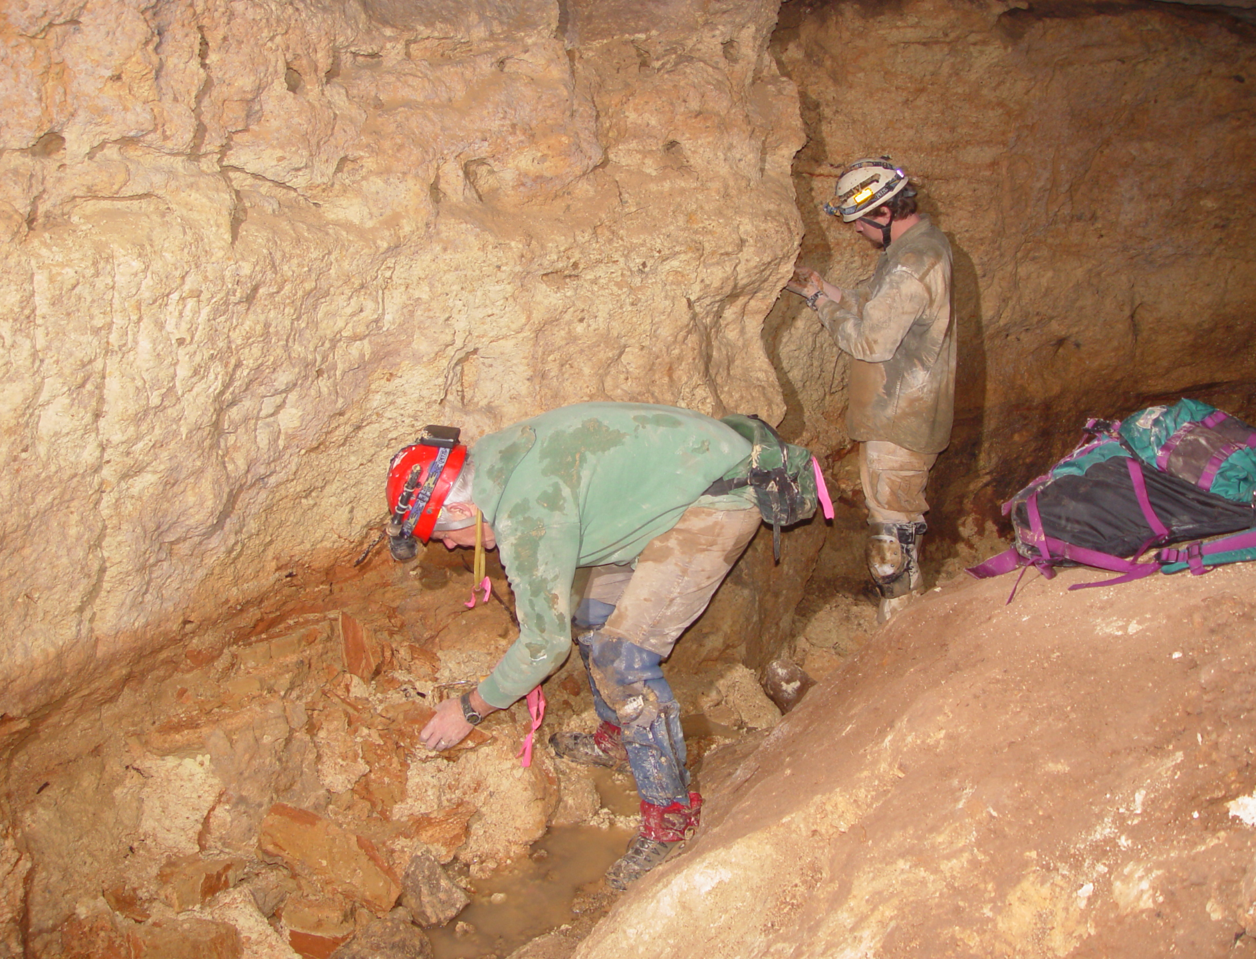
Beetles and caves: adaptations, unusual California fauna
Rolf L. Aalbu, Ph.D., Research Associate, C.A.S.
Notes:
Dave Kavanaugh & Kip Will, Carabid experts in Clay cave.

Slide 3
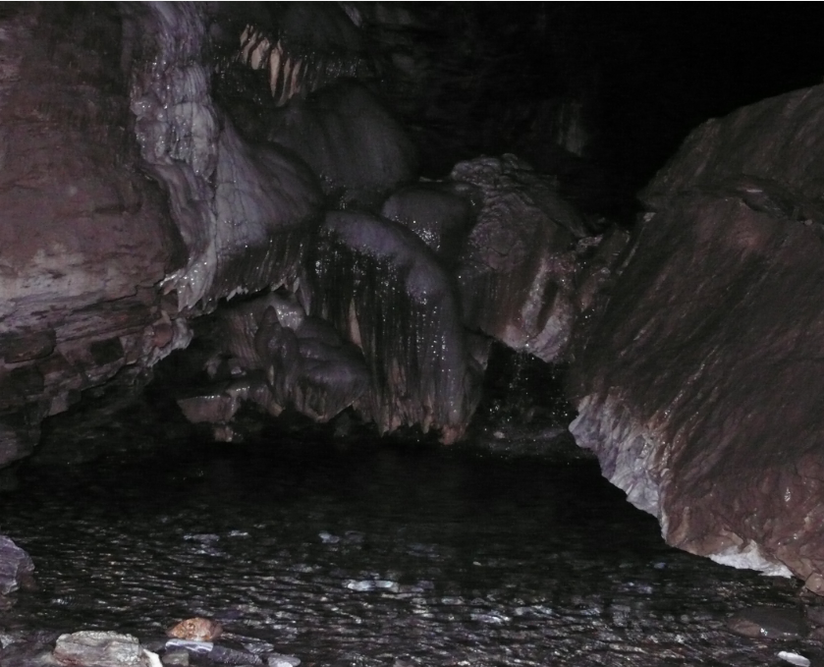
Outline
Coleoptera (beetle) abundance
Cave Coleoptera in California
Cave adaptive radiation patterns
Major cave morphological adaptations
Three main California cave beetle surveys
Other California discoveries
Comparison to other areas
Status of research on California Cave Coleoptera

Slide 4
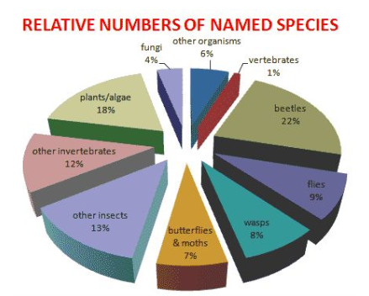
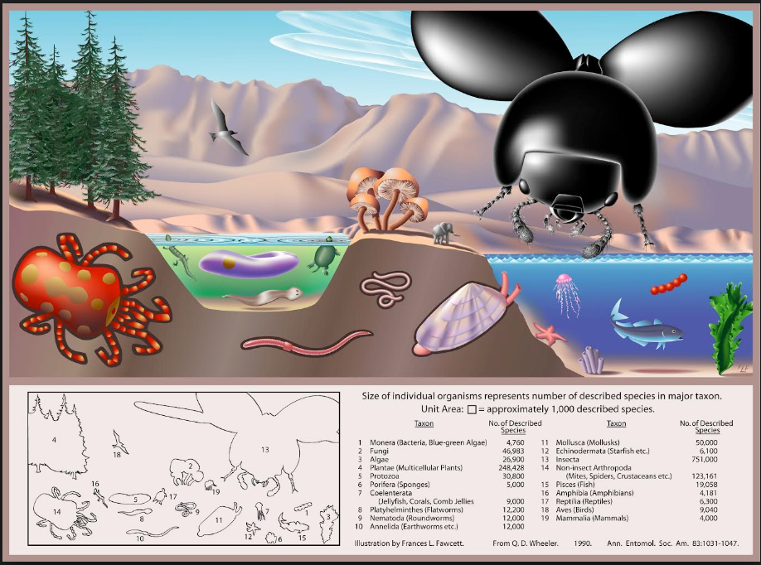
Coleoptera Abundance
211 Families

Slide 5
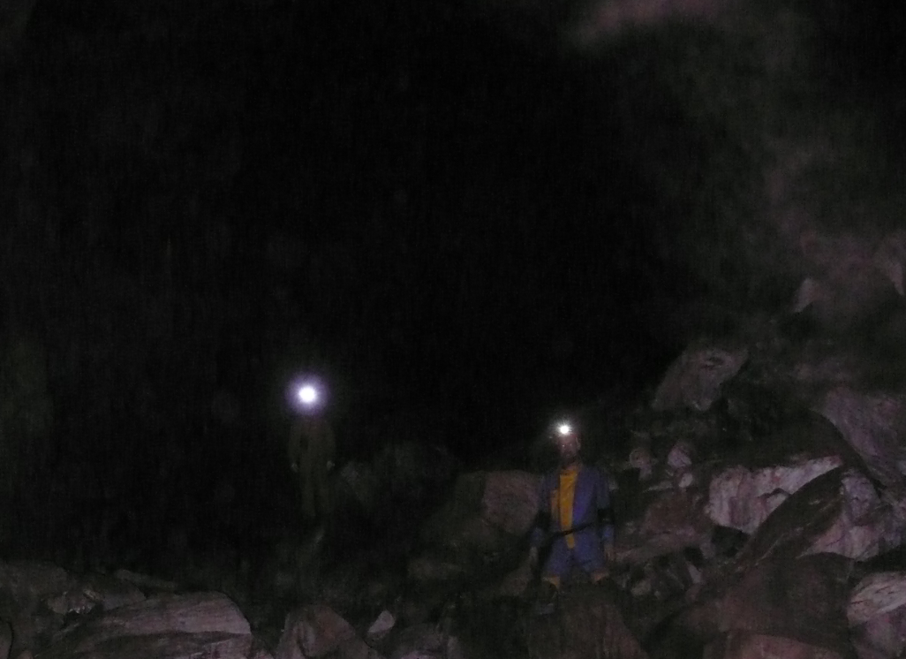
Cave Coleoptera (Beetles)
Only about 12 of the 211 families have cave modified species
In California, these include the following:
Anobiidae ( spider beetles )
Carabidae ( predaceous ground beetles )
Curculionidae ( weevils )
Leiodidae ( round fungus beetles )
Staphylinidae ( rove beetles )
Tenebrionidae ( darkling beetles )
Modified species are either Troglophiles or Troglobites
Other families include mainly Trogloxenes or Accidentals but also some Troglophiles.

Slide 6
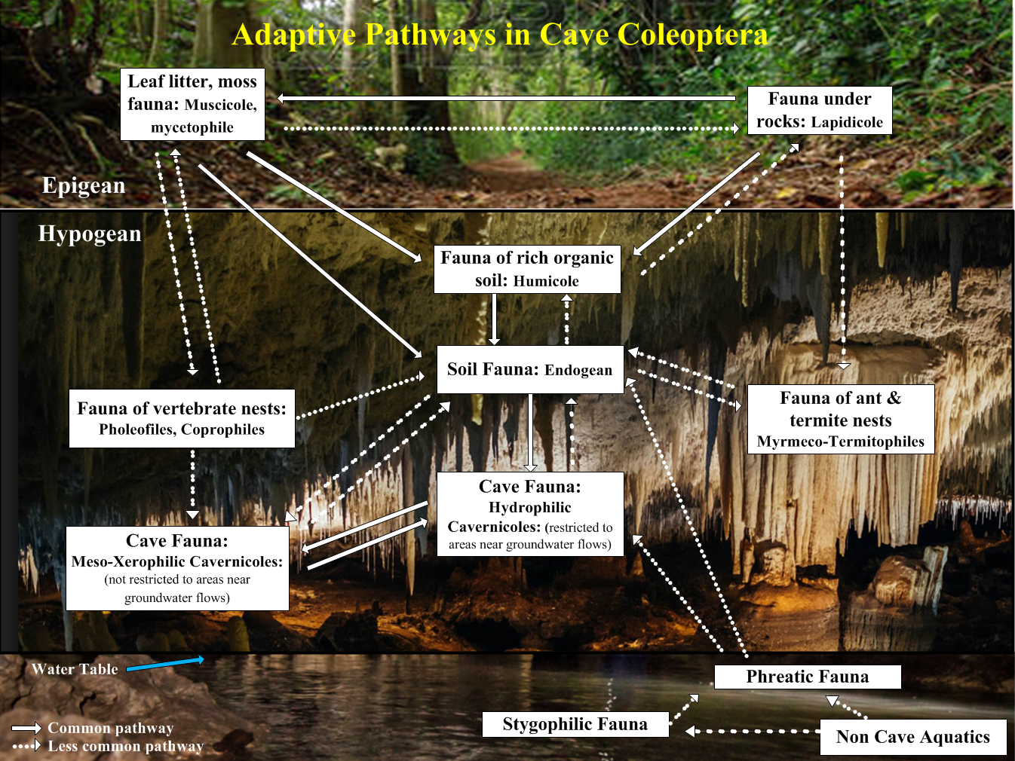

Slide 7
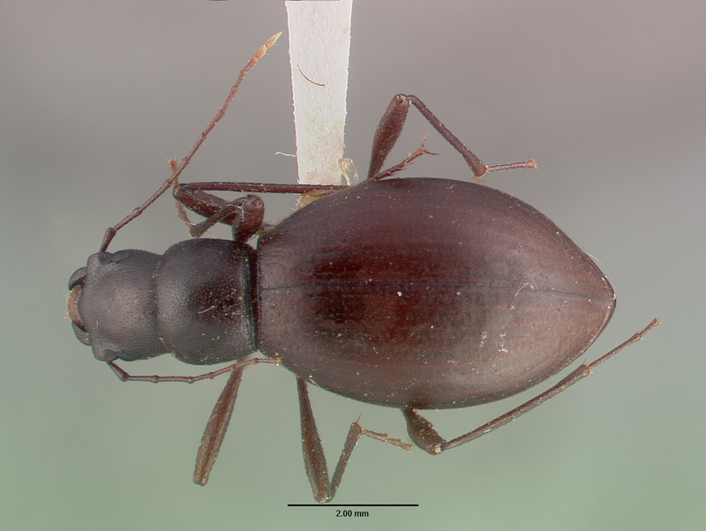
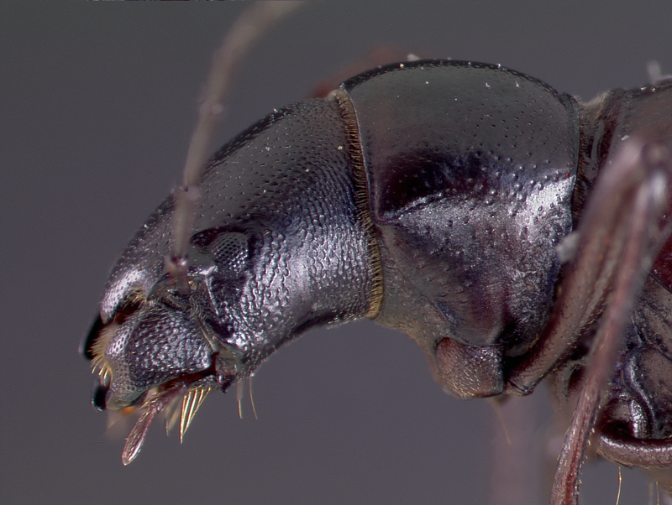
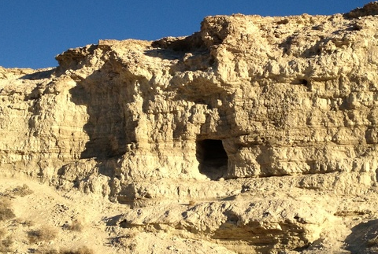
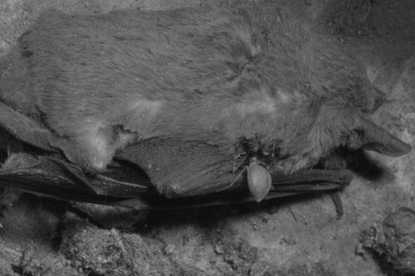
XEROPHILIC CAVERNICOLE
EschatomoxysEwagneri Blaisdell (troglophile, above)
Notes:
Lower right is a species in the same genus feeding on a dead bat.

Slide 8
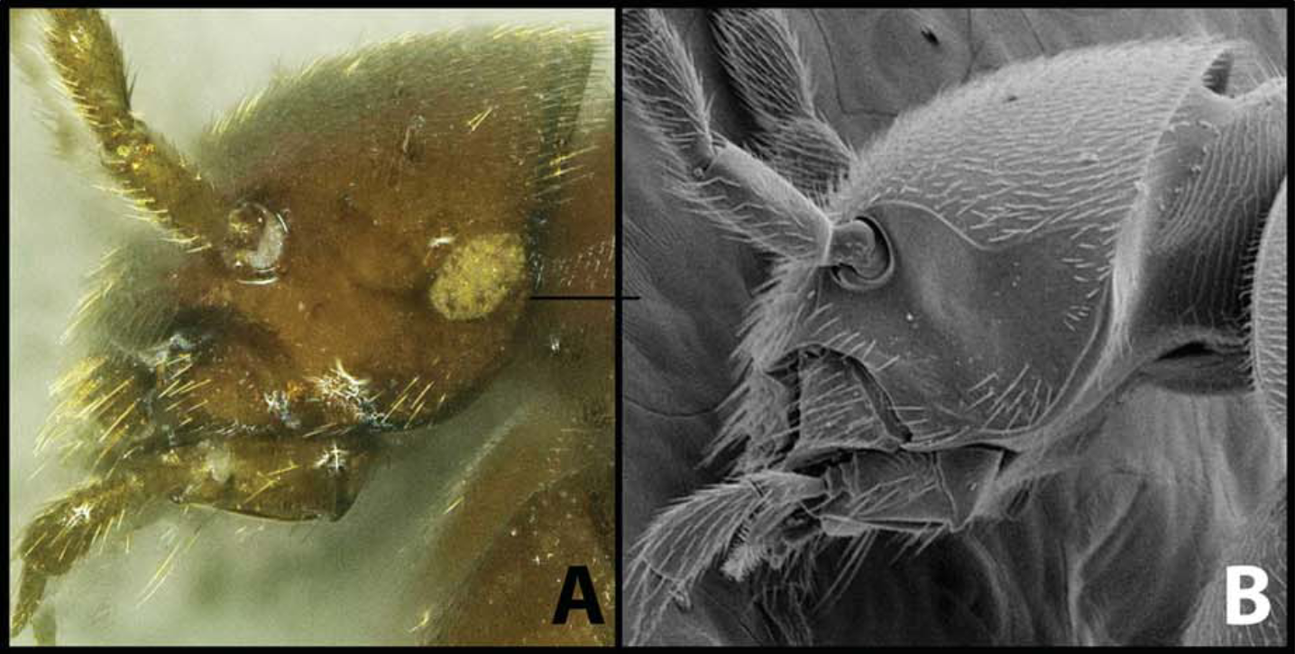
Major cave morphological adaptations in Coleoptera
Reduced eyes or lack of eyes (blind)
Blind Ptomophagus species from Arizona (troglobite)
Reflected light image of head with unpigmented remnant eye spot,
B) Head with no eye remnants *From Peck & Wynne, 2013
Notes:
In some cases the species is blind but with a “remnant eye spot or scar” as in this species of Ptomophagus

Slide 9
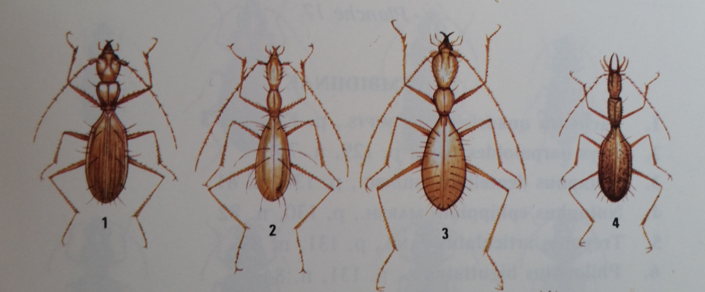
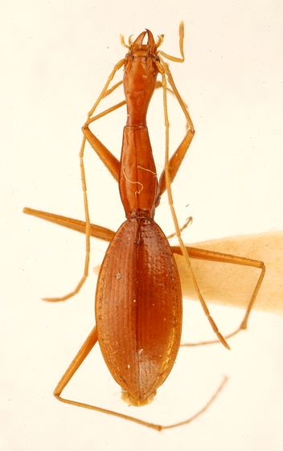
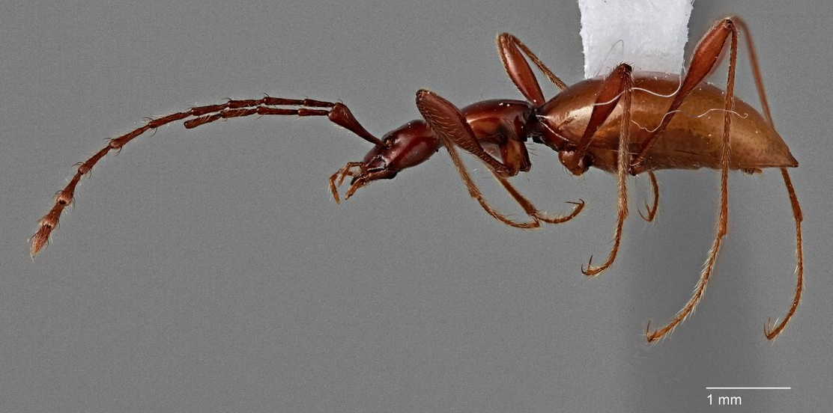
Often elongate appendages and sensory organs
Cave Trechines (Europe) CARABIDAE (troglobite)
Glacicavicola bathyscioides Westcott (Idaho)
LEIDODIDAE (troglobite)
Rhadine austinica (Texas)
CARABIDAE (troglobite)
Notes:
Notice the long tactile setae on the cave trechines upper left

Slide 10
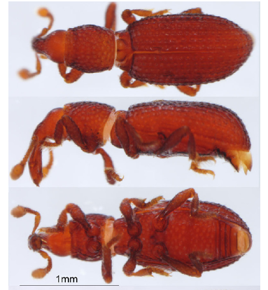
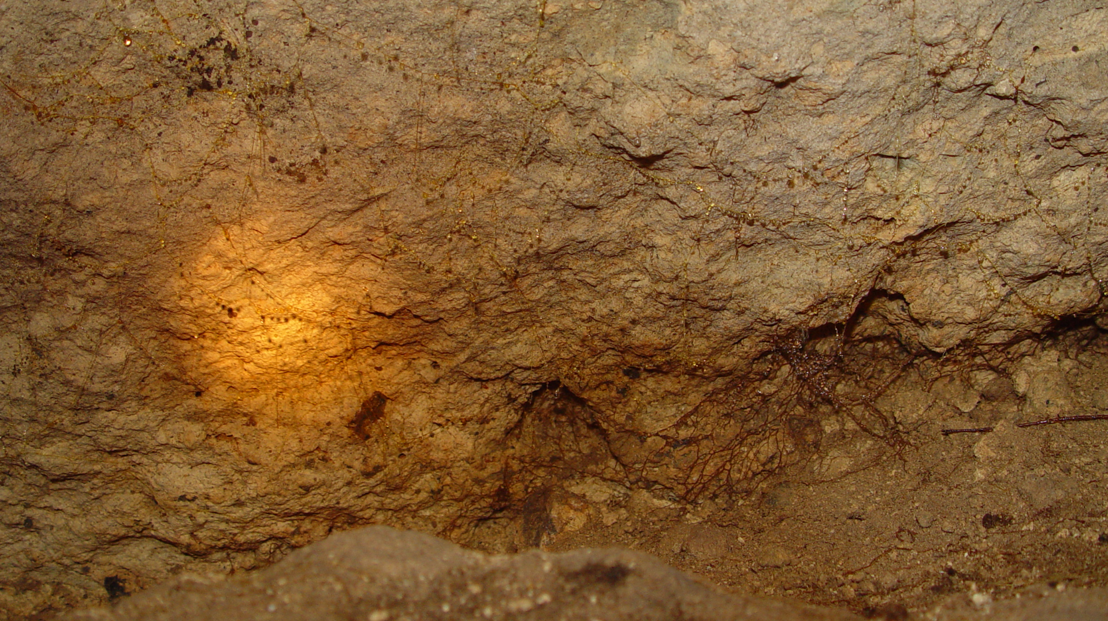
Very small size ( length 1-3 mm )
ROOT WEEVILS (CURCULIONIDAE) Three genera are found in California: Aloacybites, Schizomicrus & Gilbertiola sp.
one species of this last genus is found in Clough Cave (troglobite)

Slide 11
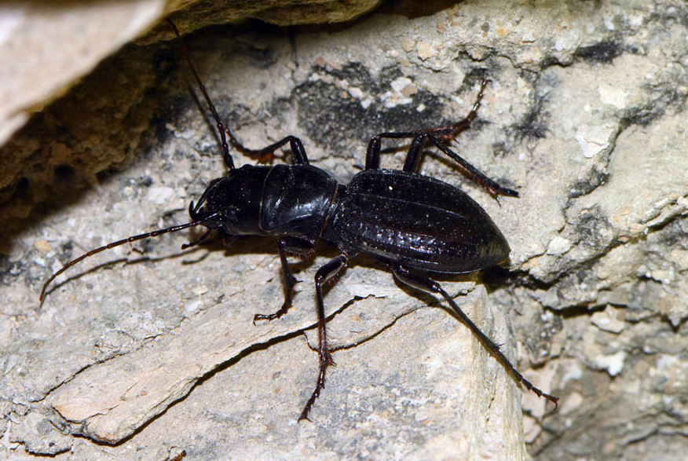
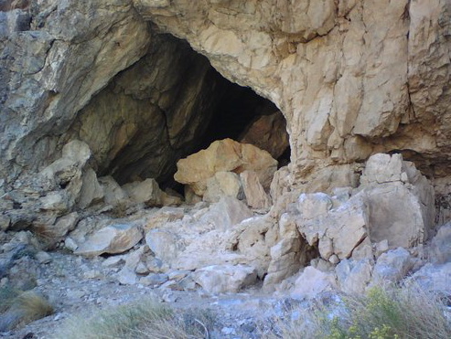
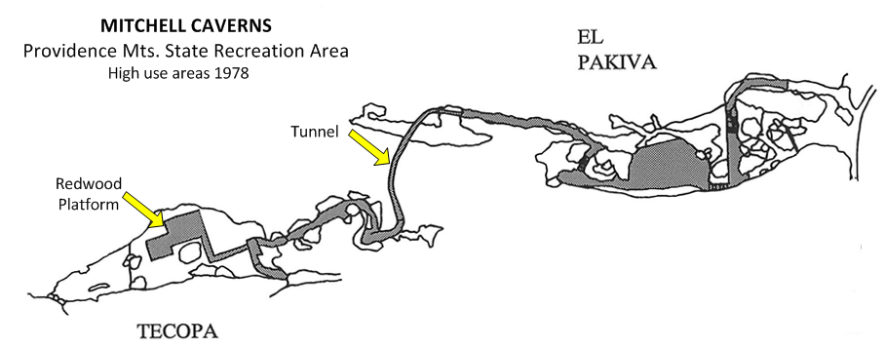
California Cave Coleoptera Surveys
Mitchell Caverns, Providence Mountains, San Bernardino County
Amblycheila schwarzi (Horn)
Notes:
Mitchell caverns is composed of two caves, joined together by a man made tunnel to facilitate tours.
My involvement with cave surveys of Coleoptera started in 1978 when I was asked to conduct a survey of the beetles in Mitchell Caverns. Apparently, someone had mentioned to the rangers that a “very rare” tiger beetle had been observed in the large room in Tecopa cave. A large redwood platform was built to prevent tours from stepping on the beetles. Unfortunately, the redwood platform was covered with the highly toxic chemical, creosote to prevent termite damage.

Slide 12
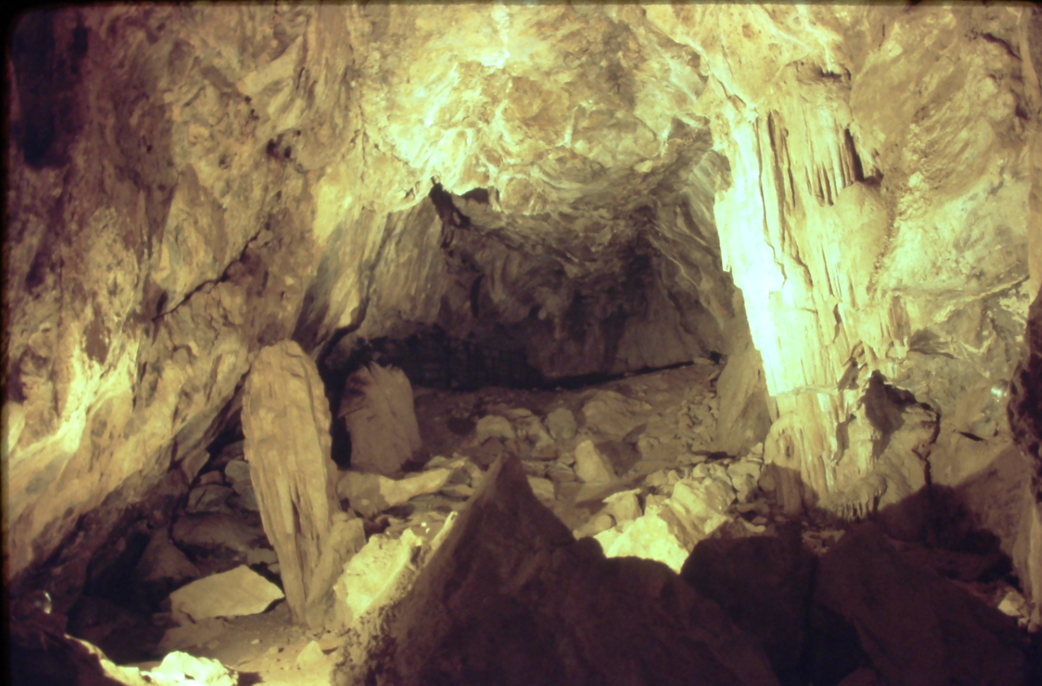
Mitchell Caverns Survey
Survey Results
23 families sampled including
6 cave adapted families
One Troglobite (new)
Eleven Troglophiles (1 new)
Thirteen Trogloxenes (1 new)
Four Accidentals
Notes:
Here is the large room in Tecopa cave. It turn out the tiger beetle was neither rare nor cave adapted being found rather commonly in the Providence mountains and other desert mountain ranges.

Slide 13
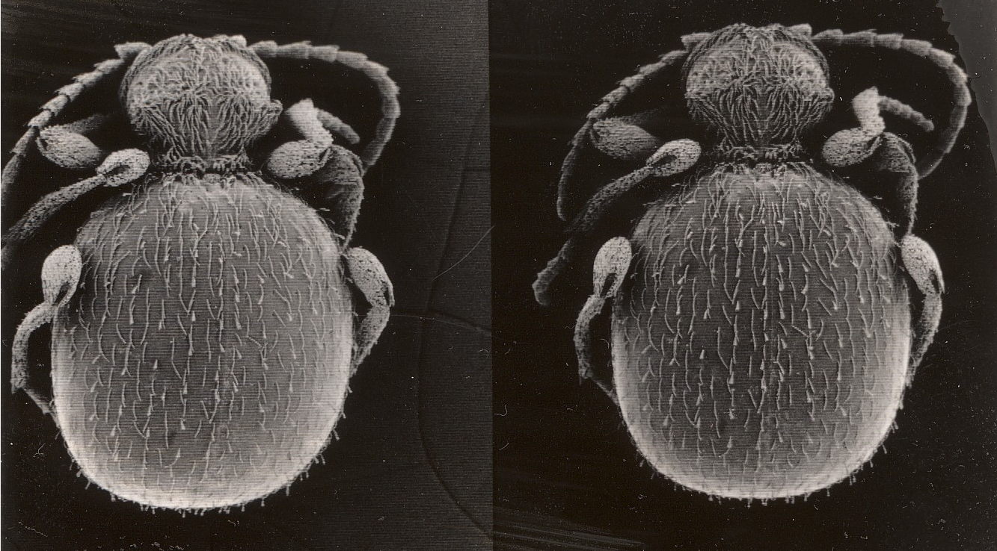
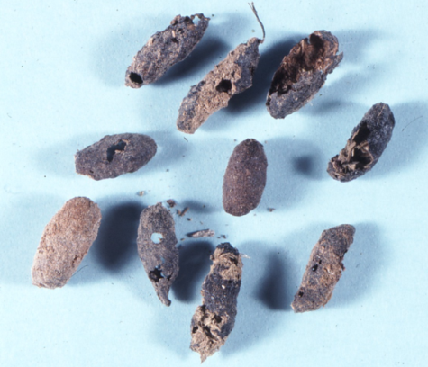
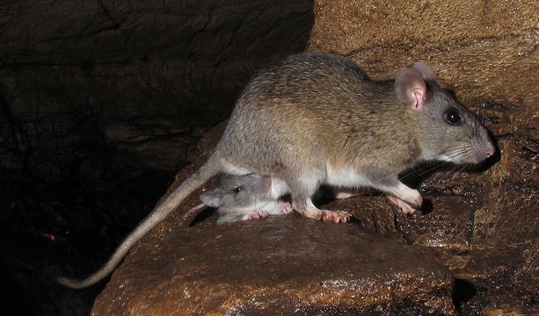
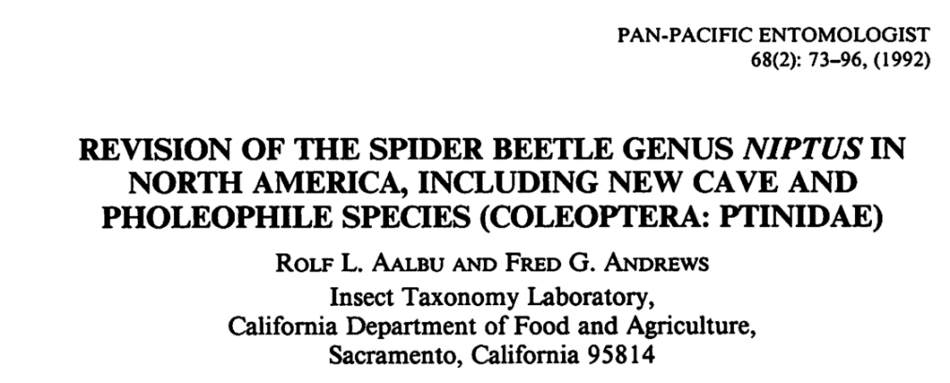
Niptus arcanus Aalbu & Andrews
(troglobite)
Notes:
One of the new species was the troglobite…

Slide 14
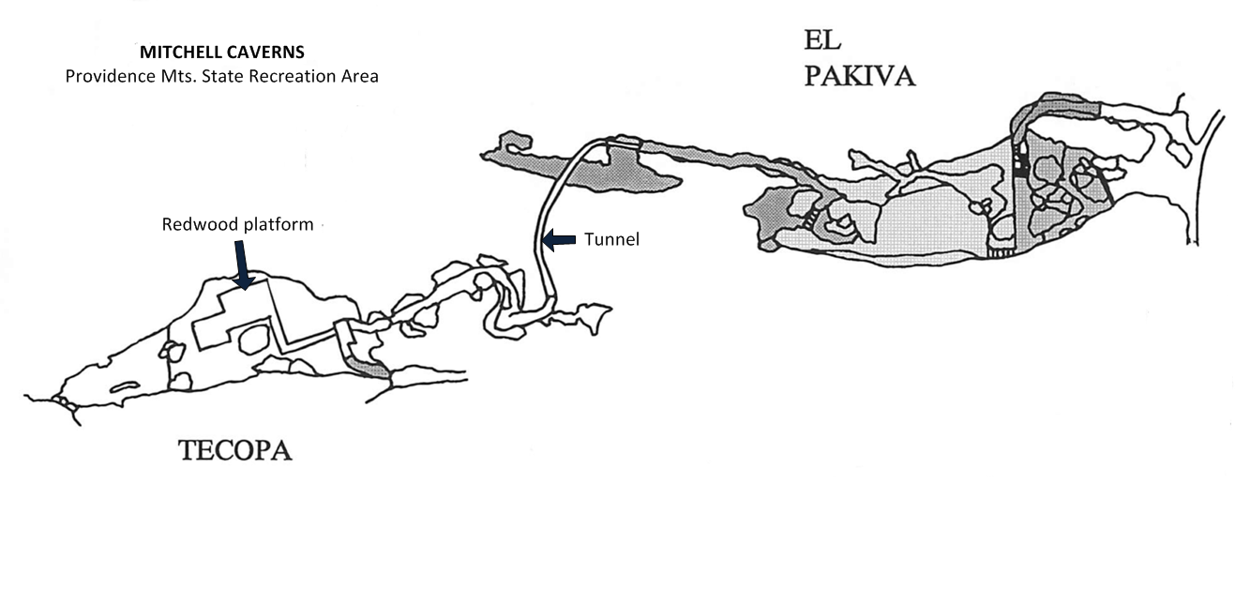
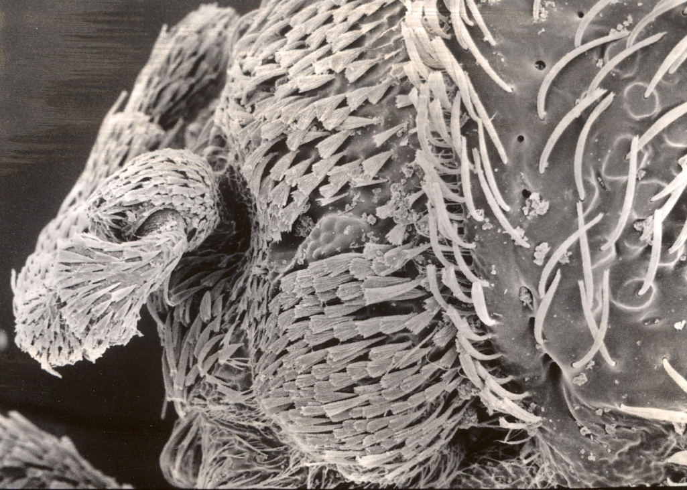
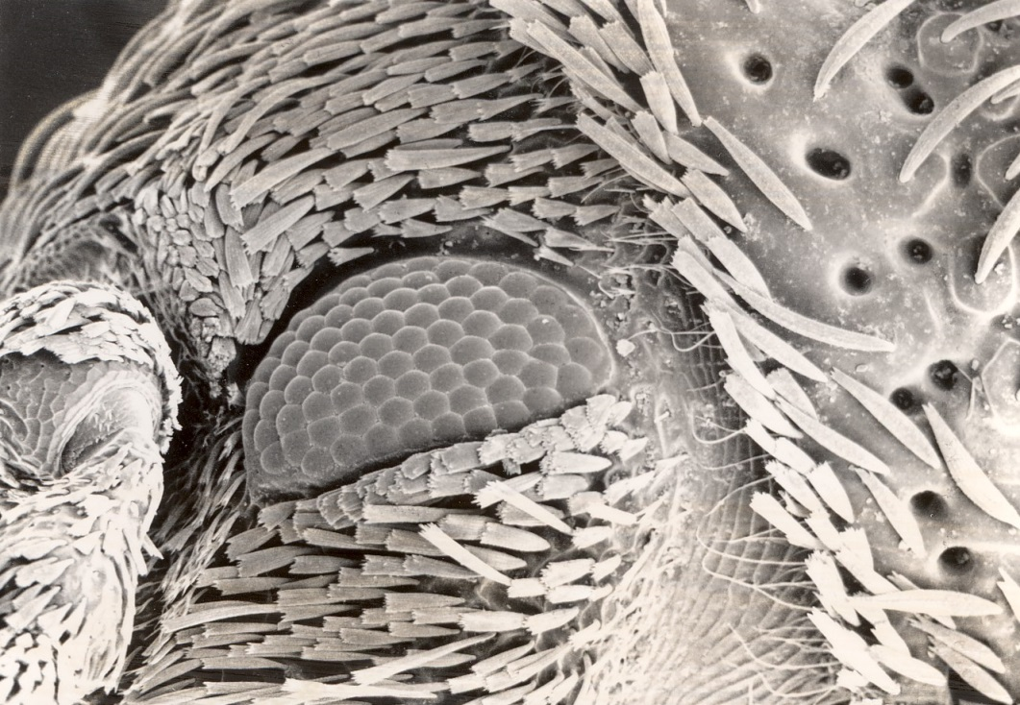
Notes:
Out of the 11 species of Niptus. Niptus arcanus is the most cave modified. It is also still restricted to El Pakiva cave and most common in the deepest areas of the cave

Slide 15
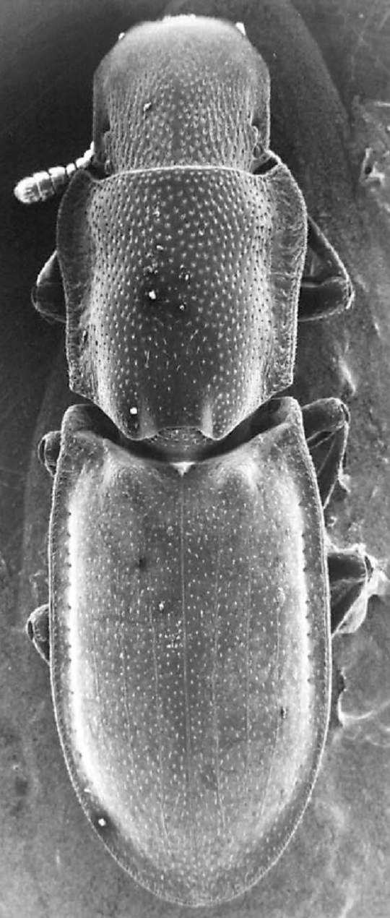
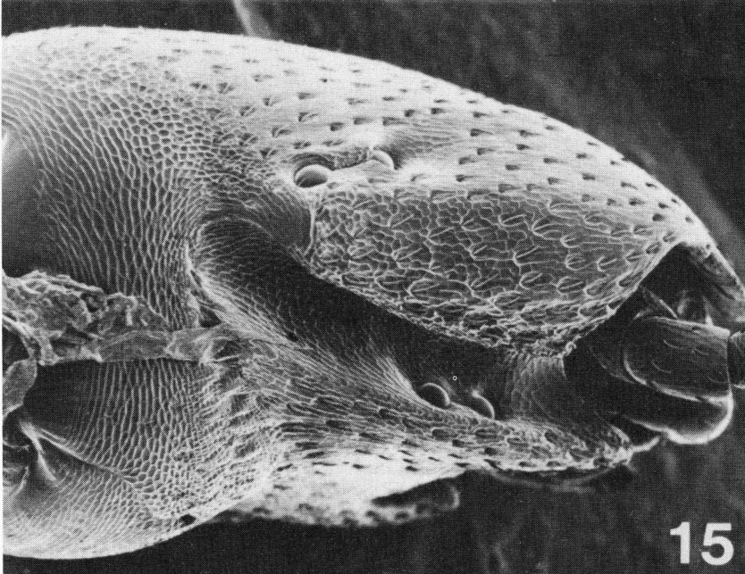
Typhlusechus chemehuevii Aalbu & Andrews (Endogean Troglophile) Length 2.4-2.8 mm.
Aalbu, R.L. & F.G. Andrews. 1985. New Species, Relationships, and Notes on the Biology of the Endogean Tentyriine genus Typhlusechus (Tenebrionidae: Stenosini). Occ. Papers Calif. Dept. Food & Agriculture. 30:1‑28.
Notes:
Another new species discovered was the endogean species Typhlusechus chemehuevii described in 1985.
Noticed the eyes split first to the top of the head and bottom of the antennal groove and the split again. This is the largest species in the genus.

Slide 16
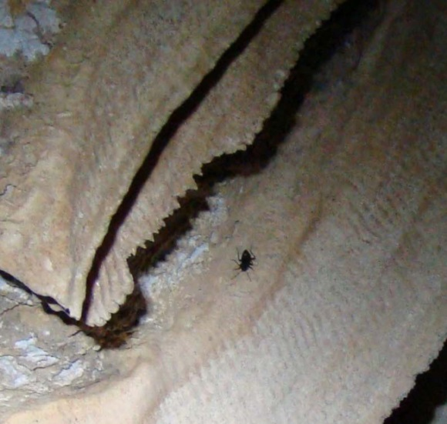
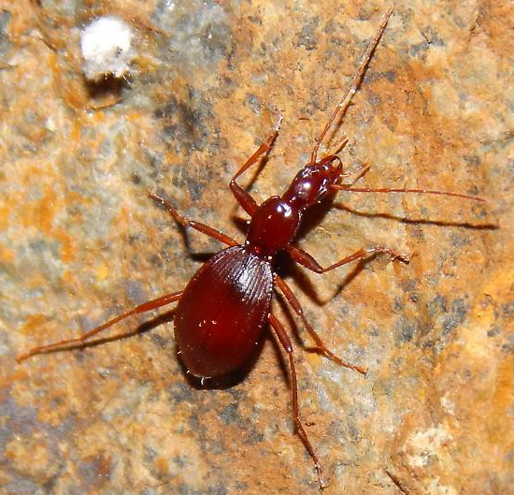
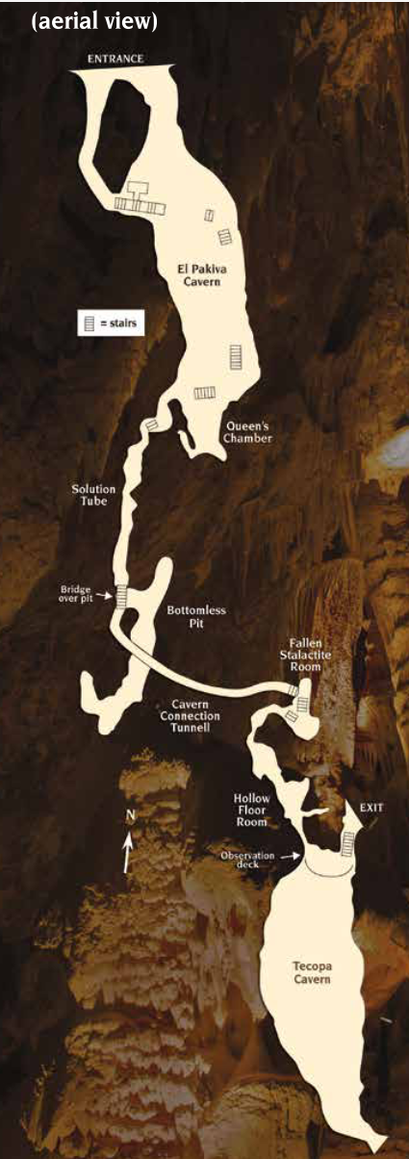
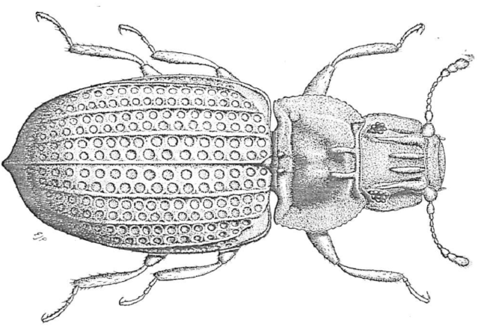
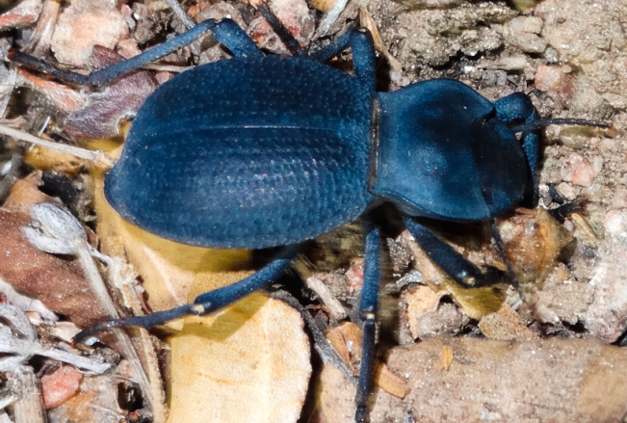
Eleodes (Metablapylis) californicus Blaisdell (troglophile) Tenebrionidae
Rhadine sp. (troglophile) Carabidae
Schizillus nununmacheri Horn (troglophile) Tenebrionidae
Metopthalmus rudis Fall (troglophile) Lathridiidae
Notes:
Here are photos of other cave adapted beetles in the cave. In 1991, just over 10 years after the initial survey, we were asked to conduct a live trapping survey on how the two cave endemics were doing. Both were maintaining good populations. The spider beetle Niptus arcanus, was still restricted to El Pakiva.

Slide 18
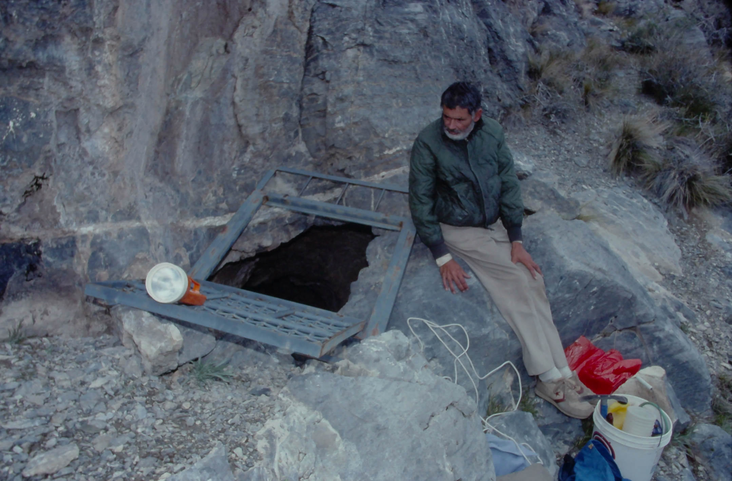
2. Poleta Cave, Inyo-White Mountains, Inyo County
Amblycheila schwarzi (W. Horn)
Notes:
The second survey started when a remarkable species was found in a cave in the Inyo-White mountains. This was a species of Eleodes (TENEBRIONIDAE) that was uniquely cave adapted in having the smallest eyes in any of the 233 known of this genus many being from caves.
In this cave, the same species of tiger beetle as found in Mitchell Caverns was quite abundant near the entrance.

Slide 19
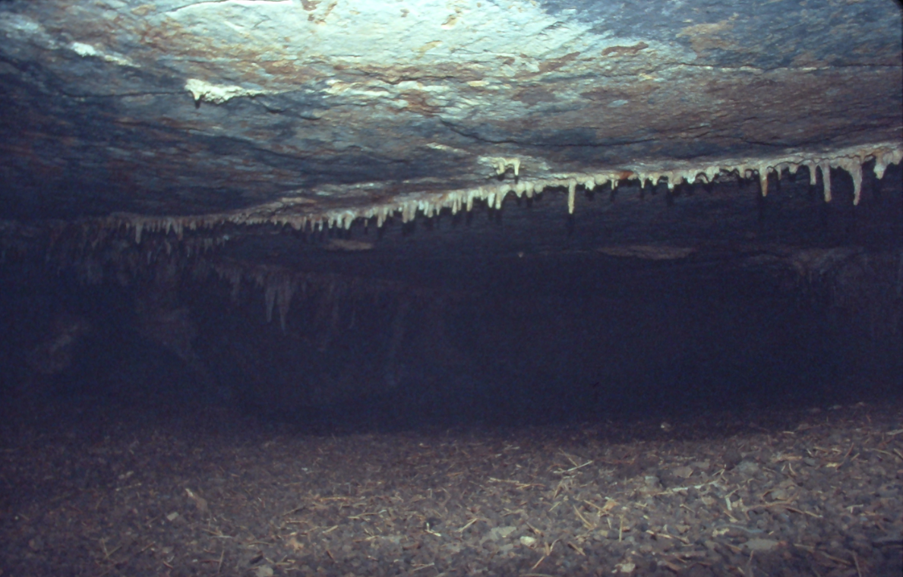
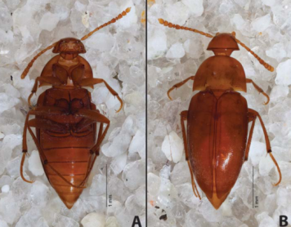
Poleta Cave new species
Ptomaphagus (Adelops) inyoensis Peck and Gnaspini (troglobite)
Eleodes (Caverneleodes) microps Aalbu, Smith, and Triplehorn (troglobite)
Notes:
Another species of troglobite was also found belonging to the family Leiodidae.
This cave is vertical and at the very bottom is a layer of possibly fossilized packrat dung which is more than a foot thick in areas and provides a crawling-swimming challenge.

Slide 20
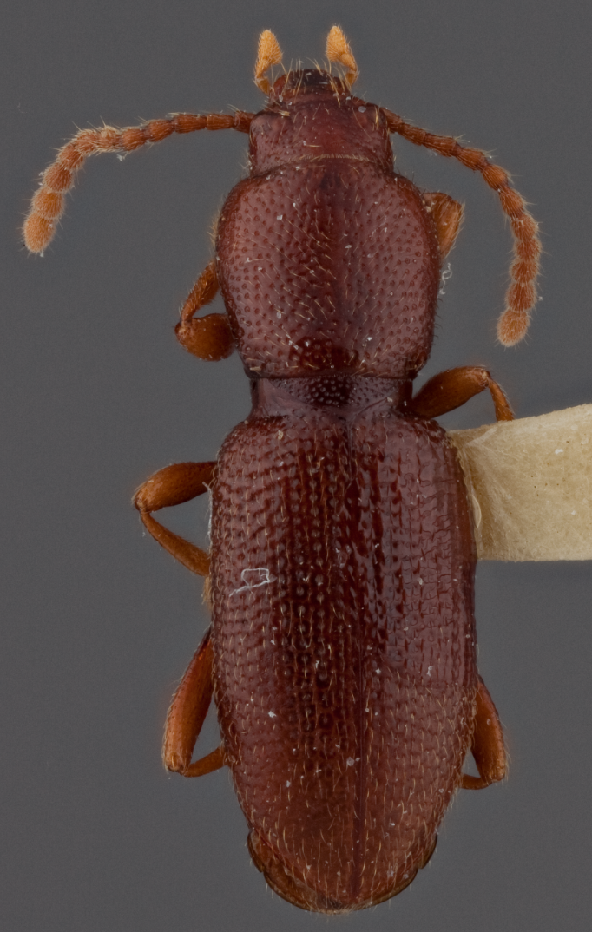
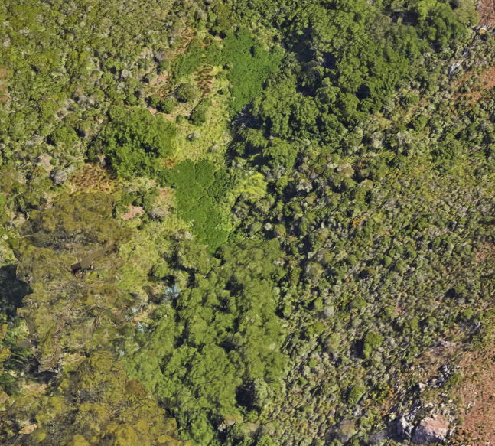
Marin Headlands, Marin County
Eschatoporis nunenmacheri Blaisdell, 1906
TENEBRIONIDAE: TRIBE??
Notes:
The third survey began with a specimen in the collection here at CAS which had been described in 1909. A few specimens were collected in the 40’ & 50’ for a total of 8 specimens.
Because of the blind unusual morphology, and uncertain tribal placement, a number of us searched for this species unsuccessfully in the 80’ & 90’. One of these had been collected by Hugh Leach, a former curator here at the academy at a place called “White’s Cave” in Napa County.
We tried looking for this cave in vain until in 2004, a local caver knew the location of this cave called Clay Cave,

Slide 21
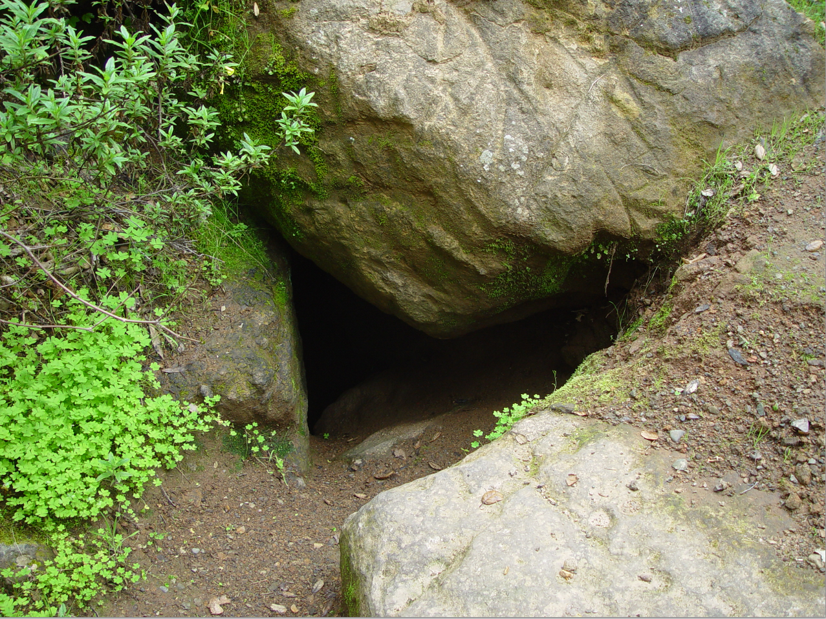
3. Clay Cave, Napa County
Notes:
Thus began the Clay cave survey. A number of new species were discovered.

Slide 22
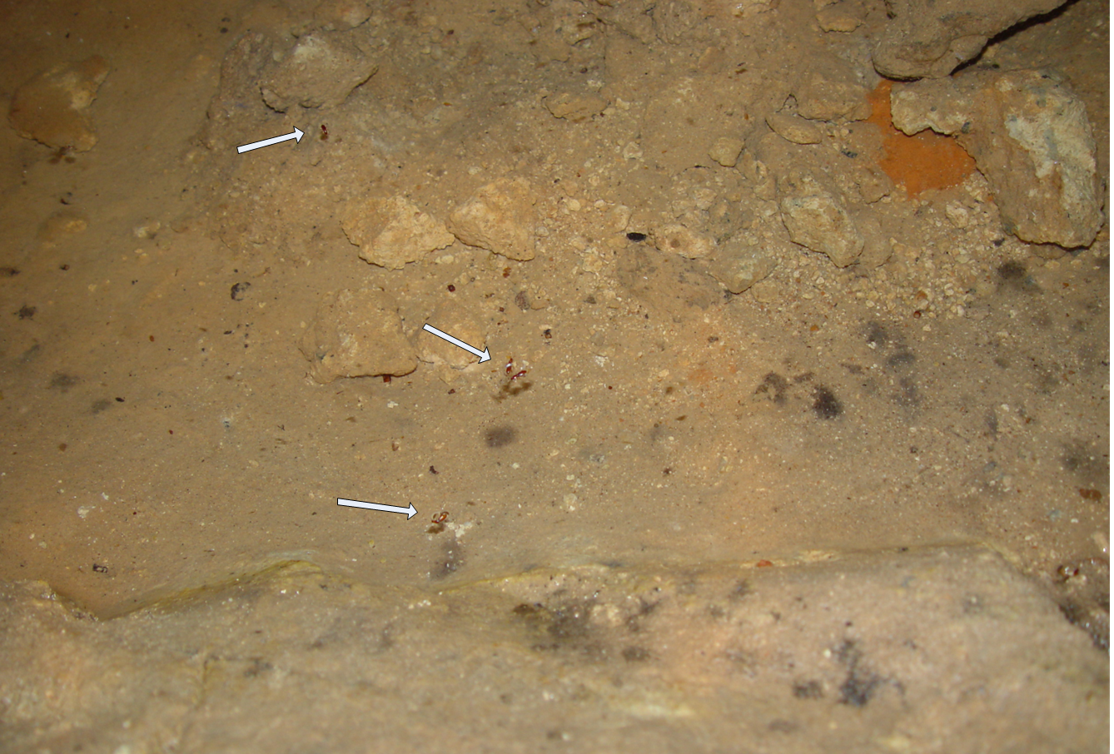
Notes:
It turned out that this was a new species and belonged to a totally new tribe of blind Tenebrionidae. This study was recently published in 2017 but came out after our cave fauna book.

Slide 23
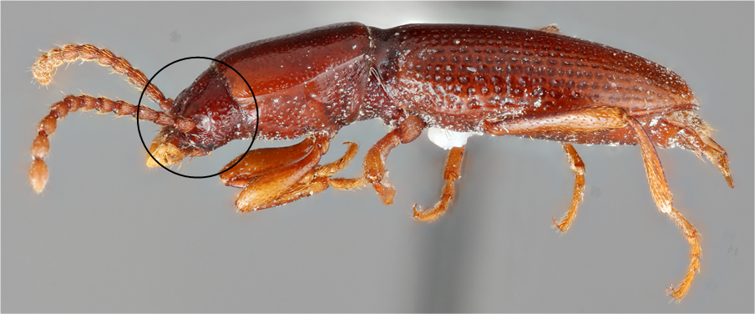
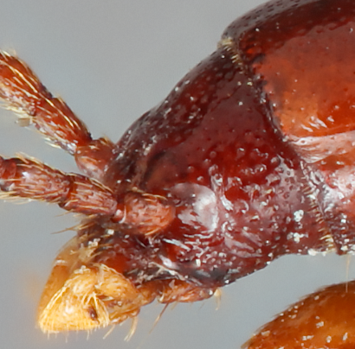
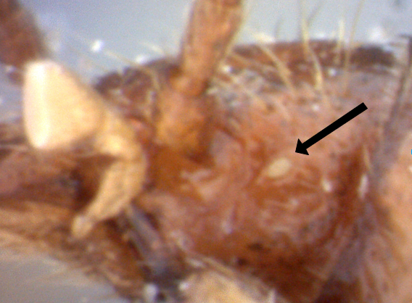
Eschatoporis styx Aalbu, Kanda & Smith, 2017
(Hydrophilic Cavernicole): Troglobite
NEW TRIBE: ESCHATOPORIINI
E. styx
E. nunenmacheri
Notes:
Among these were a new species I named Eschatoporis styx. Among other differences between the original species from Marin County which is blind but has an “eye scar” as shown by the arrow, the new species lacks even a remnant eye scar.

Slide 24
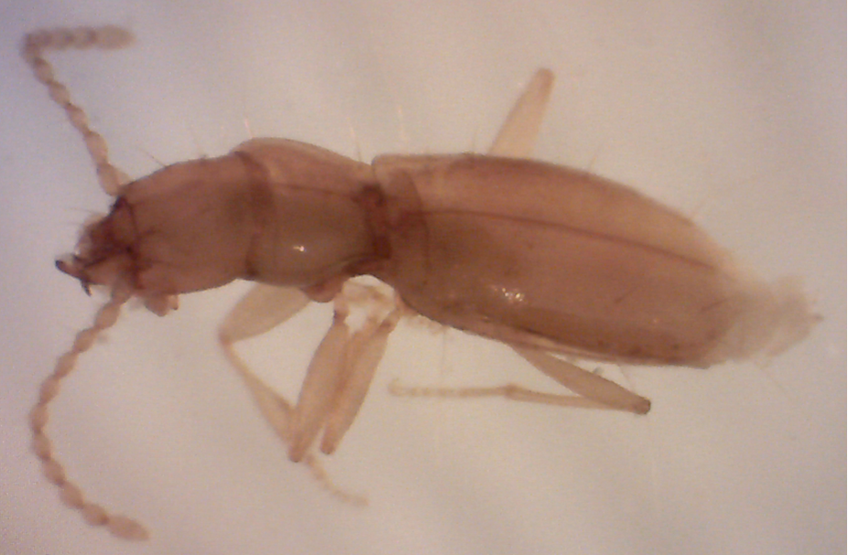
Anilina new genus & species
3 other new genera and
species Anilina from other caves
Notes:
You may recall this photo from the title slide. This is the beetle they were searching for in Clay cave. A new genus and species of blind Carabid.
Three other potentially new genera and species of this rare blind group have been found in California caves.

Slide 25
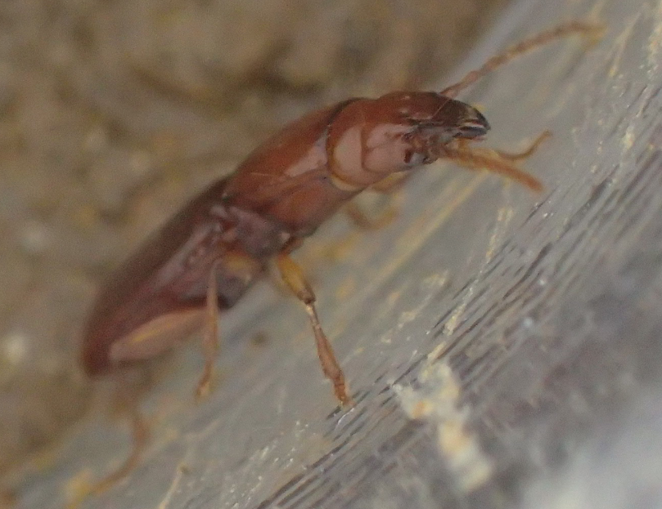
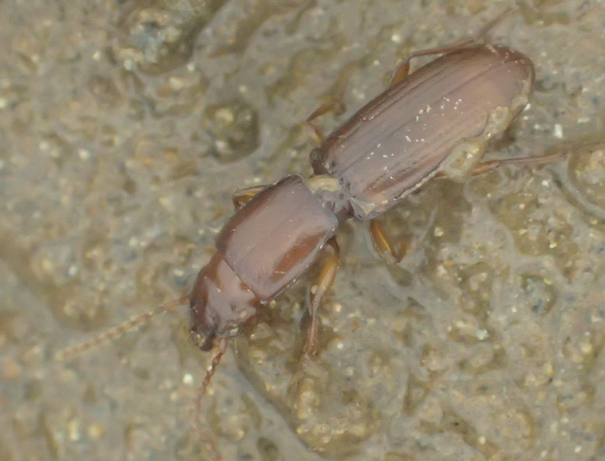
Anilina new genus & species
This rare new species is only known from two caves in the New Melones area
It is the largest by far of this group in the world
The California species in this group are currently being revised by Dave Kavanaugh, C.A.S.
Notes:
One of these is from the New Melones area

Slide 26
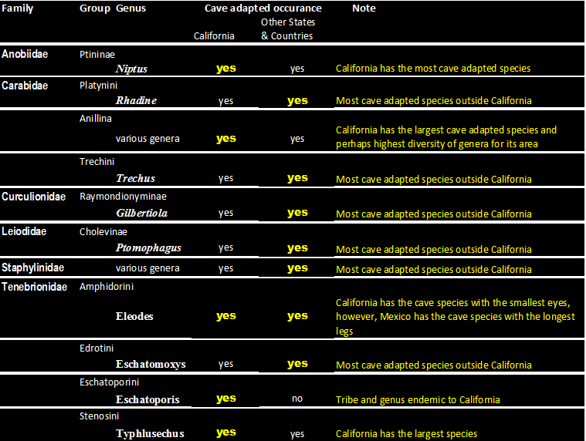
Comparison of California Cave Fauna to other areas

Slide 27
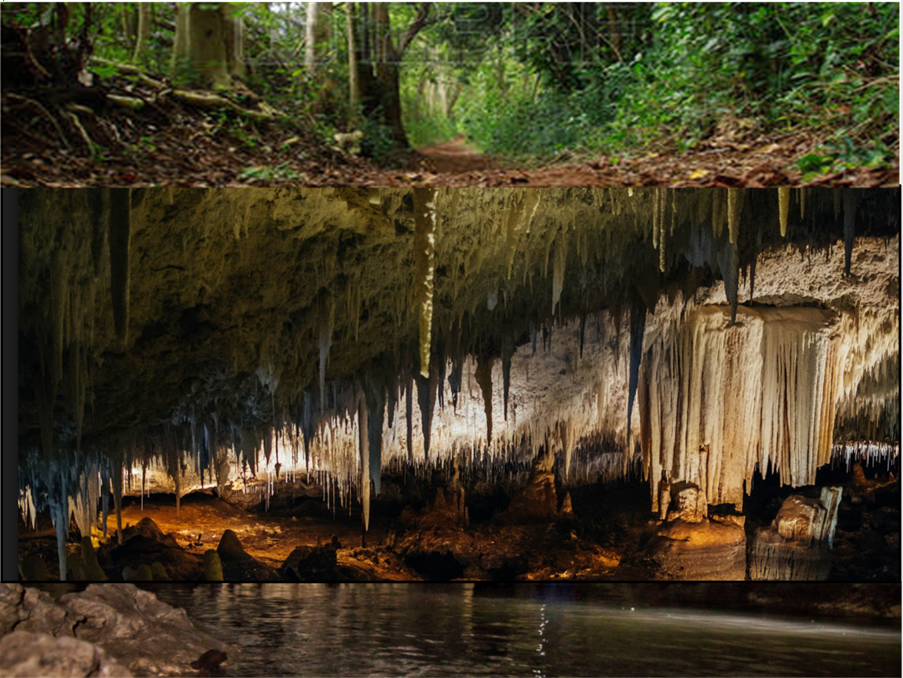
Status of research on California Cave Coleoptera
So far we have only glanced below the surface concerning the
potential diversity of California cave Coleoptera. More research
is necessary to gain a more complete understanding.
Non specialists collecting in caves tend to collect only the visible, large
species which in most cases tend to be accidentals or at most
trogloxenes
Some collected species still need identification but there are fewer and
fewer trained systematists.
Conservation of California caves is very important as long as it does not
hinder future research by unnecessary restrictions or exorbitant fees.
Notes:
fees not affordable to almost all systematists.

Slide 28
Dr. Rolf Aalbu
Beetles and Caves

